Slide 1



The BEST
Using Slybroadcast

Slide 2
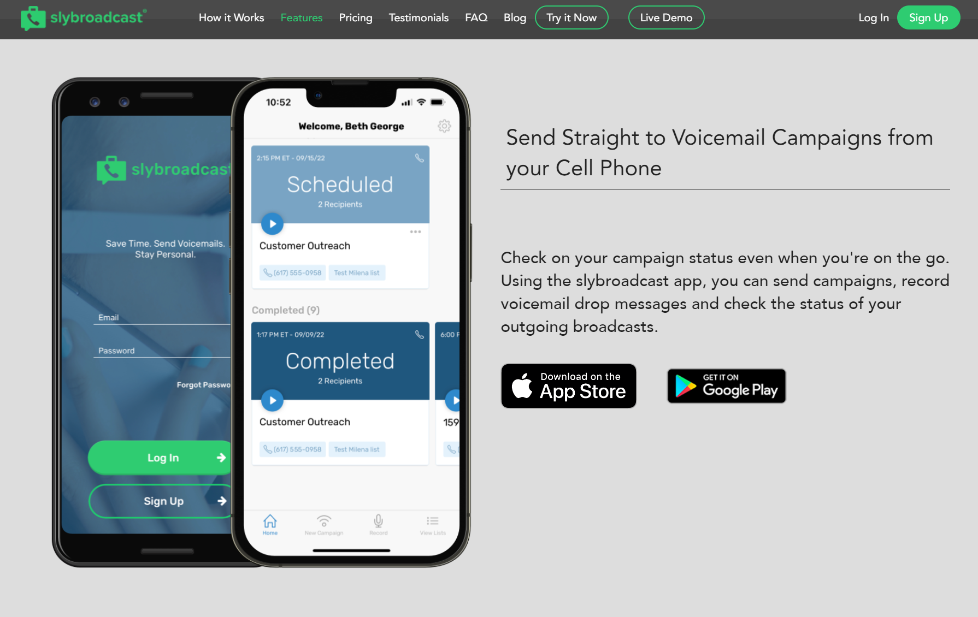

Invite to Neighborhood Open House
Invite to regular open house
I have a buyer that needs a home
Offer Neighborhood Market Report
FSBOs, Expireds, past clients, orphans, farm area, etc.

Slide 3

“Hi! This is [NAME] from [COMPANY], and the reason why I am calling is that I’m doing an open house for one of your neighbors on [DATE], and I wanted to personally invite you to come. Also, you are welcome to bring anybody that you know. It’s a beautiful house. The address is [ADDRESS], and the open house will be between [TIME]. If you have any questions, you can call or text me on my cell at [NUMBER]. Thanks!”
Neighborhood Open House Invite

Slide 4
“Hi! This is [NAME] from [COMPANY]. I’m sorry I missed you. Thank you so much for coming to my open house on [DATE]. I don’t know if you liked the house or not, but I just want to reach out to everybody who attended. It looks like we’re getting several offers, so if you’re thinking about putting in an offer, just let me know. If not, but you’re serious about looking, I have some other listings that may not be on your radar, so I encourage you to get back to me. My phone number is [NUMBER]. Thanks!”
Open House Follow Up
Version #1

Slide 5
“Hi! This is [NAME] from [COMPANY]. I’m sorry I missed you, but I wanted to reach out to you right away. You came to my open house at [ADDRESS] yesterday. Thank you so much for coming. I don’t know if you had any interest, but it turns out we’ve got a couple of offers coming in, and the deadline is tomorrow for all offers to be presented. So, if you’re thinking of it at all, please reach out to me. And even if not, I have a couple of other houses in the same price range that I’d be happy to talk to you about if you’re interested. My cell number is [NUMBER]. Thank you!
Open House Follow Up
#2

Slide 6
“Hi. This is [NAME] from [COMPANY]. The reason why I was calling is I just sold one of your neighbor’s houses that you may know: [ADDRESS]. The problem is that that listing generated such an interest in the neighborhood, and we have all of these buyers that are looking to buy, and there’s really no inventory in the community. So, I just want to reach out to all the neighbors to ask if you hear of anybody that’s thinking about selling – please pass my number on to them or call me. Also, if you’re interested and you want to know what your house is worth, I have what’s called the neighborhood market report. I believe every homeowner should do a yearly assessment of their home’s value, so I’d be happy to do that for you. There’s no charge. I’m just looking to build relationships with you and the neighbors as well. Here’s my cell number, [NUMBER]. Feel free to text me if you prefer or call me direct. Thanks!”
Just
Sold

Slide 7
“Hi! This is [NAME] from [COMPANY]. I’m just calling because I wanted to personally invite you to our upcoming event, [EVENT NAME], taking place on [DATE & TIME] at [LOCATION]. This seminar will be packed with valuable insights on the current real estate market, as well as strategies to help you achieve your real estate goals. We have some fantastic speakers lined up, and I’m confident you’ll gain a lot from attending. To RSVP or learn more about the event, please call me back at [NUMBER]. Space is limited, so be sure to reserve your spot as soon as possible. I hope to see you there! Thanks!”
Buyer or Seller Seminar Invite

Slide 8
“Hi, this is [NAME] from [COMPANY]. I’m calling because I specialize in working closely with homeowners who have found themselves in mortgage distress, especially during these difficult times and challenging economic situations. Financial struggles for families are at an all-time high, and coping with banks and crises is more than stressful. Just so you know, I have these conversations all the time, and I think it’s terrible what these banks and big businesses have done to many homeowners. So, what we’re trying to do is help homeowners through this process. I have a seller success system that helps homeowners navigate these challenges, so if you are interested in talking further about this, I can help. You can call or text me at [NUMBER]. Thank you.”
Pre-foreclosure Home

Slide 9
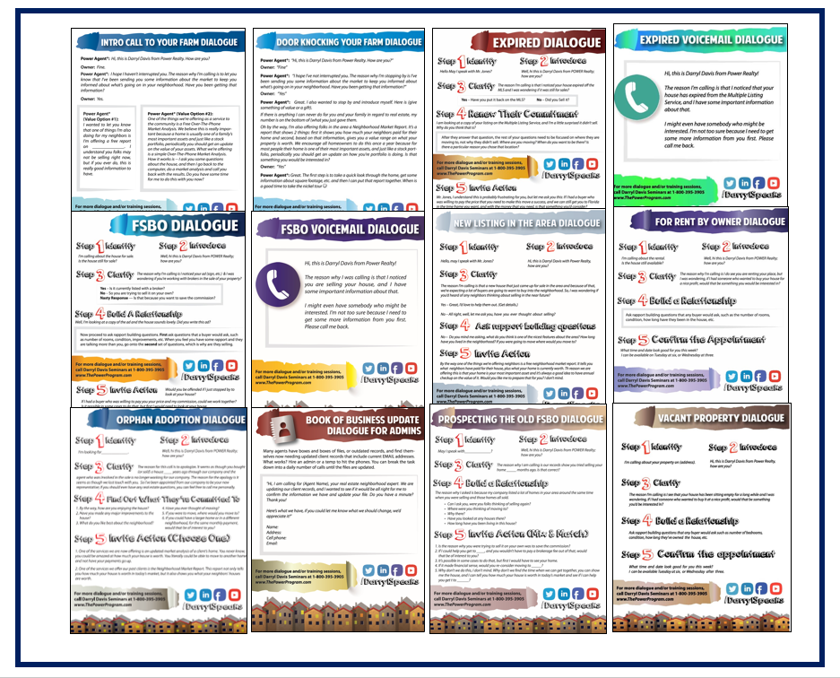
Dialogues in Your Classroom

