Slide 1




HOME
BUYER’S GUIDE
FOR NAVIGATING THE CURRENT MARKET
Your Name Here
Your title here

Slide 2

Buying a home is a big decision!
As the housing market and economy are constantly adjusting to the ever-changing circumstances around us. I want you to know that I’m here to help every step of the way as your expert guide.

Slide 3
TABLE OF
Contents
Understanding the Housing Market
  Real Estate Market Cycles
  Is Now a Good Time to Buy)
Pre-Purchase Preparation
  Are You Ready to Buy
  Get Pre-Approved for a Mortgage
  What You Need to Know About Your Credit Score
  Hiring a Real Estate Professional
  Do I need a Buyer’s Agent
  Who’s Involved in the Purchase of Your Home)
What Are the Responsibilities of a Buyer’s Agent
  How this Benefits You
  Other Things to Consider
  Buyer’s Agent Additional Responsibilities from Contract to Close
  Why Commit to an Experienced Buyer’s Agent
  What is a Buyer Agency Agreement)
05
Understanding Dual Agency
  Risks and Challenges Faced by Buyers
  As Your Buyer Agent I am Your Advocate
Let the House-Hunting Begin
  Identifying your “Must-Have’s” and “Nice-to-Have’s”
  10 Things to Consider When Choosing Your New Home
  Look at Homes!
  Things to Think About When Considering a Home
  Virtual Home Viewing
  Explore the Neighborhoods
  Types of Mortgage Loans
  Loan Application Checklist
  Make an Offer
  Negotiate the Details
  What to Include in the Offer
After You Submit an Offer
Purchasing and Closing the Deal
  Have your Home Inspection and Appraisal Done
  Secure your Financing
  Understand the Closing Costs
  The Official Closing
  Celebrate and Move In!
  Moving Checklists
  My Commitment to You, The Buyer
  Testimonials
31
08
35
17
46
47
Understanding How Buyer Agents Get Paid
  Alternate Compensation Models
  What You Don’t Know Could Cost You
24
Name here • Phone Number • Website Address • Email • Page 4

Slide 4

UNDERSTANDING THE HOUSING MARKET
Buying a new home can be an exciting experience, no matter if it’s your first or fifth time. The process seems daunting, but this guide is for anyone considering the purchase of a new home, particularly those who are first-time homebuyers. If you’re like most people looking to purchase right now, you probably have lots of questions, and that’s normal! I’ve put together this Buyer’s Guide, so you know what to expect from this process, and, even more importantly, what key things you might want to consider while buying a home.
This resource guide will explain everything right from the moment buying a house first enters your mind through moving day. I also want to highlight the benefits of working with industry professionals to ensure that you (and your future home) are in the best possible hands.
Name here • Phone Number • Website Address • Email • Page 5

Slide 5



REAL ESTATE MARKET CYCLES
The real estate market is like many things in life and business — constantly changing! That’s not a bad thing, but it’s important to understand where the market is at whenever you decide to buy. What’s important is to have a resource that you can trust to explain what market trends mean for you, and your buying and selling power.
There are three types of real estate markets:
A Seller’s Market
This happens when there are fewer houses on the market and the buyers are the ones competing for the properties. This is often when you see multiple-offer situations, and purchase price sometimes higher, even much higher than the list price. This market favors the sellers.
A Buyer’s Market
This happens when there is a flood of properties on the market, and home sellers compete to attract attention (and land the contract) from a much smaller pool of buyers. In this market, you’ll see lower price points and terms that favor the buyers.
A Balanced Market
This happens when there is a more even balance between properties for sale and buyers coming into the market. This market is the fairer and more equitable of the three, but is much less common than it’s two counterparts.
Name here • Phone Number • Website Address • Email • Page 6

Slide 6

IS NOW A GOOD TIME TO BUY?
To determine if this is the right time to buy, start by speaking to your real estate professional to find out which real estate market cycle your particular area is leaning toward. Your agent can provide you with local market statistics, trends, and a current home price evaluation.
It’s important to note here that “national” trends don’t always mean we’re seeing the same conditions locally. No markets are the same at any given time, and can vary from city to city and state to state.
A question even bigger than identifying market cycles is: “What is YOUR motivation to buy?” While some conditions may certainly favor buying, I often coach my clients to clearly identify what making a move will look and feel like for themselves and their families. This, and keeping an eye on the trends for purchasing, can be a good indicator if moving is right for you.
A good real estate professional will be able to help you fully lay out all of the information so that you have what you need to make the best possible decision for you and your family, both emotionally and financially.
Name here • Phone Number • Website Address • Email • Page 7

Slide 7


PRE-PURCHASE
Preparation
ARE YOU READY TO BUY?
WARNING! There is a lot of preparation that should be done before you even pick up the phone to call an agent. Not only should you think about what you have to do, there are also things you should avoid doing in preparation for your purchase. These can complicate or even derail the mortgage approval process and/or affect your credit rating:
    Don’t make any large purchases that might affect your credit score or debt-to-income ratio.
    Don’t buy new things for your future home - wait until after you close the sale.
    Don’t apply, co-sign, or add any new credit.
    Don’t close or consolidate any accounts/credit lines without advice from your lender.
    Don’t quit or change jobs.
    Don’t change banks.
Name here • Phone Number • Website Address • Email • Page 8

Slide 8

GET PRE-APPROVED FOR A MORTGAGE
Finding a lender before you start house-hunting is always a good idea for a few reasons. You will know upfront what mortgage amount you are approved for, so you know how much you can spend on your home. Many sellers will not even consider an offer from a buyer who is not already pre-approved, and pre-approval also makes financing after making an offer flow more smoothly. It also never hurts to get a second opinion from another lender, who may have some suggestions on incentives or rates that your first lender doesn’t have.
Your lender will help you decide how large of a loan you actually want to take out, and will guide you through how your property taxes, homeowner’s insurance and closing costs will be factored into your final numbers.
WHAT YOU NEED TO KNOW ABOUT YOUR CREDIT SCORE
While FHA loans technically require a minimum credit score limit of 580, higher scores in the 700+ range will get you better interest rates. Your FICO score will be one of the main determining factors for the type of loan you qualify for, and any increase in the interest rate can affect your overall monthly payment and what you end up paying over the life of the loan term.
There is a large disparity in how loans are approved between all the different lenders, so you may need to phone around to see what sorts of loans might be available to you.
Name here • Phone Number • Website Address • Email • Page 9

Slide 9
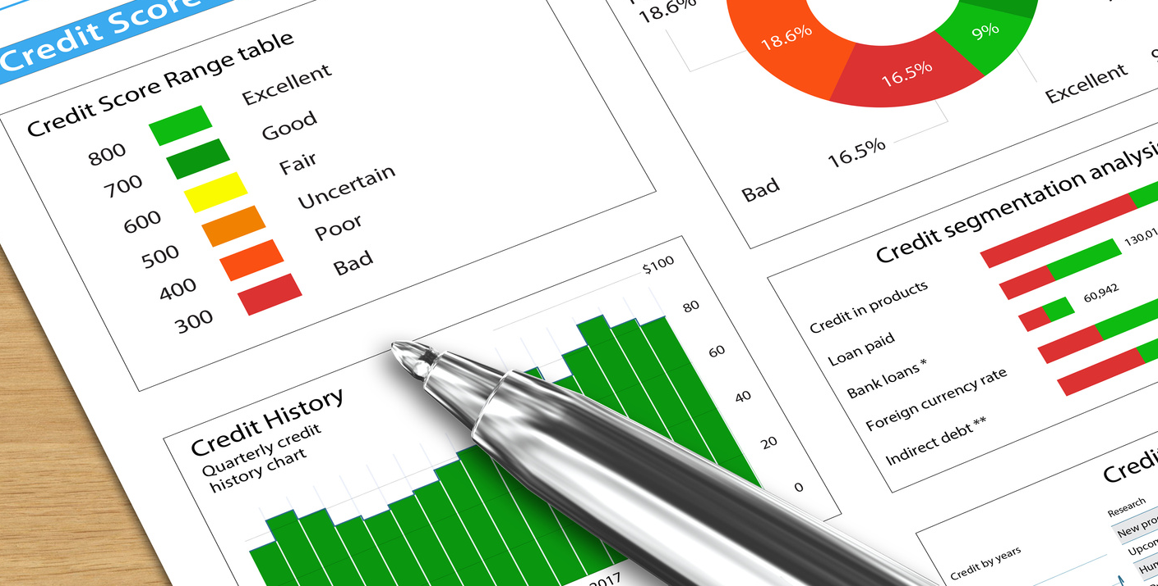
Things That Can Hurt Your Credit Score
  What is your payment history like? Were you prompt with your payments? Late or missed payments will negatively affect your credit rating.
  If you owe more than 33% of your total credit line, that will dramatically lower your credit score. So, a great strategy is to pay down your credit cards below that 33% threshold.
HIRING A REAL ESTATE PROFESSIONAL
A licensed real estate professional will provide much more than the mere service of helping you find your ideal home. Real estate agents are expert negotiators, seasoned financial advisors, and superb navigators of the transaction, start to finish. A professional real estate agent is your best resource when buying your home, hands down.
If that isn’t enough, listen to the 93% of homeowners polled, who agreed that YES, you should absolutely work with a real estate professional through this process!
Name here • Phone Number • Website Address • Email • Page 10

Slide 10

DO I NEED A BUYER’S AGENT?
A buyer’s agent is a licensed, professional real estate agent who represents home buyers throughout the purchasing process. Unlike a listing agent, who represents the seller and prioritizes the seller's interests, a buyer’s agent is legally obligated to advocate for the buyer’s best interests.
Signing a Buyer’s Agency Agreement comes with the benefit of having a dedicated professional to help you find and secure your ideal home. With an experienced agent, the process of identifying suitable properties, negotiating contracts, and closing the transaction becomes much smoother. This means you won't have to spend countless hours searching for homes or navigating complex listings on your own. Your agent will ensure that the homes you visit meet your criteria and fit within your budget.
I would be happy to explain the process of the Buyer Agency Agreement in more detail and answer any questions you may have!
Name here • Phone Number • Website Address • Email • Page 11

Slide 11

They Protect Your Best Interests
Just as you’d turn to a trusted surgeon for a medical procedure or an attorney to help with a legal woe or contract, hiring a professional real estate agent helps to ensure that all yours, and your family’s interests are well served. From navigating complicated processes to negotiating on your behalf, it’s important to have an advocate on your side.
They’ve Done the Homework
In the United States, it takes between 60-180 hours of coursework before someone can even sit for the real estate exam. During that time, we learn principles, which include property valuation, escrow procedures, financing, and taxes. We learn state and federal law, which includes writing binding contracts and leases, titles, liens and encumbrances, and unlawful discrimination. We then learn safe and fair practices for working with sellers and buyers that include communication skills, marketing, pricing, and a wide spectrum of necessary technology and tools needed to list and sell real estate in today’s world.
Standards Matter
There is a difference between just being a licensed agent and being a POWER AGENT®. A POWER AGENT® is a real estate agent who is an active member of the POWER Program®, which was founded in 1993 and is home to the top 1% of the best real estate professionals in the United States, who have chosen to build their businesses on qualities like integrity and service. To participate in this organization, agents must not only have a valid license but also impeccable conduct records and adhere to an extensive Code of Ethics and Standards of Practice.
Name here • Phone Number • Website Address • Email • Page 12

Slide 12
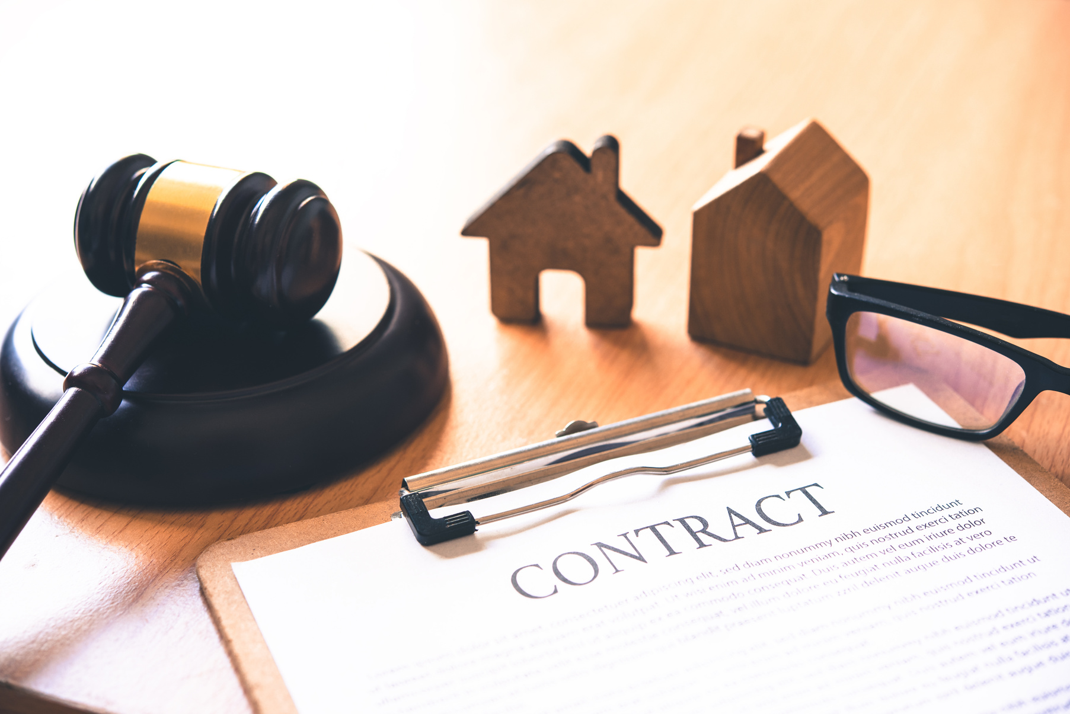
For buyers like you, that means hiring a POWER AGENT® allows you more peace of mind, knowing that your representative has been thoroughly vetted, values integrity and transparency, and has sworn an oath to uphold those professional ethics and standards.
"Legal Ease"
As you might imagine, managing contracts, addendums, contingencies, and caveats in a world that has become more litigious than ever is not for the faint of heart. Just as a CPA might help you successfully wade through ever-changing tax codes to confidently file a tax return, a real estate professional helps home sellers expertly and legally navigate prices, terms, conditions, and contracts with a lot more peace of mind.
Name here • Phone Number • Website Address • Email • Page 13

Slide 13

Enlisting the services of a professional buyer’s agent is similar to using an accountant to help you with your taxes, a doctor to help you with your health care, or a mechanic to help you with your car. If you had the time to devote to learning everything about accounting, medicine, and automotive mechanics, you could perform these services yourself. But who has the time? This is why you allow other professionals to help you in their specific areas of expertise.
I will take care of the hassles of everyday real estate transactions for you. I let you concentrate on your full-time job while I do my job. I will guide you through the home-buying process and exclusively represent your interests as I help you find a home, present your contract offer, negotiate, and close on your home!
Name here • Phone Number • Website Address • Email • Page 14

Slide 14

WHO’S INVOLVED IN THE PURCHASE
of Your Home?
When it comes to negotiating the purchase of a home, these are the parties involved that will influence the agreed-upon prices and conditions:
  You, the Buyer – are looking to find a home that fits your needs and make a sound investment
  The Buyer’s Agent – the real estate agent charged with negotiating on your behalf and looking out for your best interests
  The Buyer’s Attorney – protects your legal interests
  The Seller – looking to sell their home and get the highest price and best return on their investment.
  The Seller’s Agent – the real estate agent who will protect the interests and negotiate the price and terms on behalf of the seller
  The Seller’s Attorney – protect the legal interests of the seller
  The Home Inspection company – enlisted by the buyers to find issues (large or small) with the home to give you further negotiating power and knowledge of what you might be purchasing
  The Appraiser – will appraise the home’s value objectively on behalf of the lender
  Mortgage lender or Bank – will oversee the lending process, mortgage options, and closing.
  Title Company – ensures a clear title and transfer of property.
Name here • Phone Number • Website Address • Email • Page 15

Slide 15


Who is Directing YOUR Transaction?
Sellers
Buyers
Appraisers
Engineers
Seller’s Attorney
Buyer’s Attorney
Title Company
Home Inspector
Bank Representative
Your Real Estate
Professional
Name here • Phone Number • Website Address • Email • Page 16

Slide 16

WHAT ARE THE RESPONSIBILITIES
OF A BUYER’S AGENT?
Fiduciary Duty: My fiduciary responsibility is to YOU. At all times, I am acting in your best interests from negotiating the best price and terms for you to prioritizing your needs, commitments, and goals. My goal? To work hard for you so that you can get your best possible outcome, and have a positive experience at the same time.
Property Search and Viewing Coordination: Not only will I work hard to locate the best properties that fit your goals and commitments, but I will also take care of scheduling showings for you, stay up to date on the local market to make sure you get the best deal, track down all disclosures, and communicate actively with other agents in the area to find you the perfect home.
Expert Advice: I live and breathe real estate so that I can offer you my expertise in your local market, the value of properties in the area, financing options, and finding the best home for the best terms. I can also walk you through the complex legal jargon to make sure you are protected and confident when you finally put your pen to paper and sign the contract.
Name here • Phone Number • Website Address • Email • Page 17

Slide 17

Negotiation: Negotiation is a big part of the home buying process -- this is where the magic happens! Not only do I negotiate the best possible price and terms for you through frequent communication and discussion, but I make your offer stand out in the sea of competition. There are many ways to work together with the listing agent to ensure we get the best possible deal, and this includes negotiating things like:
  Your most optimal closing date
  The best contingency clauses to protect you and your interests
  Repair options or credits from the seller
  What items are included or excluded with the sale
  A potential rent-back agreement, benefiting you and the seller in the event they cannot move out by closing.
  Some or all of the closing costs
  A home warranty, payable by the seller
  Any escalation clauses in case of a multiple offer scenario
  An earnest money deposit to prove how serious you are in purchasing the home
  Ensuring the title is clear with costs potentially paid for by the seller
  The time and location of the closing and passing off the keys for your convenience.
Coordination of the Home-Buying Transaction: The process of purchasing a home can feel a little daunting because there’s a lot happening at the same time. I am here to coordinate and streamline this process for you, from organizing the inspection, make sure all deadlines are met, communicate frequently with other agents and vendors involved during the process such as mortgage brokers, home inspectors, title companies, lawyers, and insurance agents. I keep on top of things to ensure that the transaction remains on schedule so we’re ready to go by our negotiated closing date.
Name here • Phone Number • Website Address • Email • Page 18

Slide 18

HOW THIS BENEFITS YOU:
You have Professional Representation: My fiduciary duty is solely to you, so I will look out exclusively for your interests throughout the whole transaction.
Access to My Extensive Resources: I can connect you to my extensive list of properties, including exclusive listings and my vast network of vendors such as plumbers, contractors, lawyers, and more.
Less Time, Less Stress: I manage the details through the transaction so you don’t have to, saving you time and energy. You can rest easy, knowing you are in good hands.
A Strong Negotiator In Your Corner: You can relax, knowing that I have your goals and commitments at the top of my mind, and will get you the best price and terms possible.
Plenty of Guidance and Support: I am your coach and will guide you through every step of the process, providing support and advice whether its your first home or your 10th.
OTHER THINGS TO CONSIDER:
Exclusive Agreements: All buyers must have a Buyer Agency Agreement before being shown any homes, making me your exclusive agent who will serve your best interests.
Professional Fees: Due to the NAR Settlement, the professional fee structures for buyers and sellers are being de-coupled in many circumstances. When in our first meeting, we will discuss fee details and options. In short, commission can be negotiated to be paid either by the seller, by the buyer, by the listing broker, or a combination. There are many options, so we will discuss which choice is best for you.
Compatibility: A real estate agent is your partner and coach during the home buying process, so hire an agent whom you feel you are compatible with, and whom you can trust. This is vital to having a positive experience and working relationship.
Name here • Phone Number • Website Address • Email • Page 19

Slide 19

In Summary, as your Buyer’s Agent, I will…
  Promote and protect your interests.
  Sign an agency agreement saying I will represent you, the buyer.
  Ask you to be loyal and not work with other REALTORS®️.
  Locate and show available properties from any company, pointing out strengths and weaknesses to you while honoring your price limits.
  Provide important information about neighborhoods, floor plans, and resale characteristics.
  Counsel you about property values.
  Keep your bargaining and financial position confidential.
  Advise you on offers you may want to make on a property.
  Assist you in arranging property inspections.
  Submit offers to purchase promptly.
  Respond honestly and accurately to questions.
  Consult with you regarding counter-offers.
  Negotiate only on your behalf.
  Follow-up on necessary corrections and/or repairs.
  Supply information for any services requested.
  Provide guidance and support throughout the closing process.
  Stay in touch with you regarding future market conditions that may affect your home value.
  Appreciate any recommendations to family and friends!
Name here • Phone Number • Website Address • Email • Page 20

Slide 20

Managing All Documentation:
I efficiently manage all the paperwork and documentation during the course of the transaction, from creating and reviewing all amendments, disclosures, and details to ensuring that every document is a true reflection of your needs, commitments, and goals.
Coaching Through Legal Contracts:
Not everybody speaks "legalese", which is why I will walk you through every point in the legal contract to make sure you understand and are comfortable with each point. I will explain the confusing jargon and their implications, making sure your rights and interests are protected.
Coordinating Inspections:
There are several different types of inspections that your dream home may go through such as general home inspections, pests, and radon, which can locate any potential issues with the home. I will make sure inspection companies stay on schedule, and book further, more specialized inspections as needed.
Buyer’s Agent Additional Responsibilities from Contract to Close:
Support and Advice: I am your vigilant advocate and coach from the beginning to the end of the home-buying process. My ultimate goal is to ensure a positive experience for you, and to make this journey as smooth and successful as possible while keeping you informed every step along the way.
Managing Timelines and Deadlines:
There's a lot that happens in a short amount of time during the home-buying process, and I make sure that every detail is tracked and monitored to ensure that every step from contract to close is taken care of on or before the deadlines to keep this process on track. I stay in frequent communication with all parties so we can stay on schedule.
Name here • Phone Number • Website Address • Email • Page 21

Slide 21

Review of Inspections Reports:
Once the inspections are completed, I will review the reports and go over them with you. Should any major issues be found, we will decide our best course of action, whether it's further negotiating for repairs, or re-evaluating your offer.
Overseeing Contractors: If and when any repair work or renovations are required, I obtain quotes for any work needed, and stay in communication with the contractors to make sure all repairs and renos are completed on time.
Conducting the Final Walk-Through: Prior to closing, I conduct a final walk-through together with you to ensure the property is in the condition as was agreed upon, and that all terms of the sale are met.
Guiding You Through the Closing Process: I guide you through the transaction from contract to closing, which includes the finalization of your financing, analyzing all closing documents to ensure correctness, and making sure that all financial and legal obligations are met.
Ongoing Recommendations and Information: My commitment to you doesn't end when the keys change hands. I will continue to offer information, recommendations, and advice about what is happening in the market. This includes offering insights into market trends, data, and past sales on an ongoing basis so that you are in the know.
Why Commit to an Experienced Buyer’s Agent?
The relationship between a buyer and their real estate agent is a partnership. As a buyer's agent, my role is to be your knowledgable coach, helping you navigate the homebuying process with ease, successfully resulting in the home of your dreams. It's my goal to make this experiencee a positive one, and while some buyers might feel nervous about signing a Buyer Agency Agreement, this document establishes our relationship so that I can do the best possible job for you. Without this agreement in place, my responsibility is to work for the seller's best interest. The Buyer’s Agency Agreement protects your rights, protects against liability, and creates a legally binding relationship where I can serve as your skilled representative to negotiate the best possible price and terms on your behalf.
Name here • Phone Number • Website Address • Email • Page 22

Slide 22

OK, SO... WHAT IS A
AGENCY AGREEMENT:
BUYER AGENCY AGREEMENT?
With the recent National Association of REALTORS® Settlement, one of the terms they settled on is that all buyers must have formal representation. This legal agreement offers the buyer protection - they now have someone in their corner who has a fiduciary duty to look out for their best interests. This agreement outlines all the duties and obligations of both parties, from duration of the relationship, type of property, geographic area, and the agent's professional fee. This agreement brings transparency and clarity to the relationship, ensuring everyone is on the same page and there are no surprises.
DEFINITION
A Buyers Agency Agreement is just what it sounds like: a legal agreement that outlines the relationship and expectations between a buyer and their real estate agent or broker through the duration of the home-buying process. Pretty simple, right?
Name here • Phone Number • Website Address • Email • Page 23

Slide 23

UNDERSTANDING HOW BUYER AGENTS GET PAID:
A SIMPLE EXPLANATION
CURRENT AS OF 06/17/2024
Beginning in August, 2024, all agents by law, will be required to use buyer representation agreements and establish their compensation PRIOR to showing a property.
As a buyer's agent, my compensation typically comes from a commission-based model, paid out in various possible ways. See the next page for a simplified break down to give you a clear picture on how it works.
Name here • Phone Number • Website Address • Email • Page 24

Slide 24
ALTERNATE COMPENSATION MODELS:
1
Negotiating the Professional Fee with the Seller:
3
Taking Advantage of Seller Concessions:
If you are considering making on offer on a listing that is NOT offering a commission to buyer agents, I can negotiate with the seller or the seller's agent to discuss including my buyer's agent professional fee in the terms. This becomes part of the overall negotiation process when making an offer on the property.
Another option could be to adjust the purchase offer to indirectly cover my professional fee, rolling it into your financing so you aren’t paying out of pocket. As a brief example, if the home is listed for $400,000 and the average compensation would be $12,000, we could offer $412,000 and add the condition to the offer that the seller pays a $12,000 commission to the buyer's agent. This way, the net to the seller remains the same and your compensation obligations are rolled into the overall price of the home.
A seller concession is an arrangement where the seller agrees to cover a portion of the buyer's closing costs. This can include various fees associated with purchasing a home, such as loan origination fees, appraisal fees, points, and more. By reducing your upfront out-of-pocket expenses, seller concessions can make the home purchase more affordable, potentially offsetting direct commission obligations.
If the seller refuses to pay my buyer’s agent professional fee and it cannot be included in the purchase price, you, as the buyer, may need to cover my fee directly. We would discuss and agree on this before proceeding with making an offer on any property, and it will be outlined in our buyer's agency agreement.
2
Adding the Fee to the Purchase Offer:
4
Buyer Pays Commission Direct:
OR ANY COMBINATION OF THE ABOVE
Name here • Phone Number • Website Address • Email • Page 25

Slide 25

WHAT YOU DON’T KNOW COULD COST YOU
When you're in the market to buy a home, it's vitally important to understand the overall flow of real estate transactions, especially regarding agent representation and compensation. One key concept that can significantly impact the process is the principle of "procuring cause." Most procuring cause issues arise when two cooperating brokers or agents claim they’re entitled to the buyer’s side commission.
PROCURING CAUSE: SIMPLIFIED
Procuring cause is a term used in real estate to determine which agent is entitled to the commission on a property sale. It refers to the actions that directly lead to the sale of a property.
Name here • Phone Number • Website Address • Email • Page 26

Slide 26



HERE ARE SOME EXAMPLES THAT MAY UNKNOWINGLY PUT YOU IN THE POSITION OF PAYING COMPENSATION OUT OF POCKET:
1. Neglecting to Inform Other Agents
Visiting open houses on your own is a great way to learn what you like and dislike. Make sure to register with the host agent and let them know you're partnering with an agent already. Without disclosing your current buyer-agent relationship, the selling agent may be justified in claiming they have procuring clause and are owed the buyer’s side fee.
2. For Sale By Owner
Please ensure you inform your agent if you decide to contact the owner of a FSBO property directly. This is important because it helps avoid complications that can arise. For instance, some FSBO sellers might be less willing to pay a buyer's agent commission if they believe you are unrepresented. By keeping me in the loop, we can ensure a smoother process and better negotiation outcomes.
3. New Construction
Creating your dream home is an adventure. Surprisingly to most buyers, the builder's role is very much like a traditional home seller. Your agent will represent you as a buyer and use their expertise to make sure you get the absolute best deal possible. Many builders have their own in-house agent. Without your own representative, you may be subject to paying their fee also. Take advantage of your agent’s expertise by ensuring you follow their policies when visiting developments.
Name here • Phone Number • Website Address • Email • Page 27

Slide 27
WHAT YOU DON’T KNOW COULD COST YOU
#1: Contacting a Listing Agent Directly
If you contact a listing agent directly to view a property without involving your agent, it could affect who receives the commission. In some instances, the seller pays the listing agent, who then shares that commission with the buyer's agent responsible for the sale. If the listing agent shows you the property and initiates the transaction, they may claim to be the procuring cause of the sale and seek the buyer’s agent compensation. If you signed a legally binding Buyer Agency Agreement, you could be legally required to pay both.
Why This Matters: If the listing agent claims to be the procuring cause, they might be entitled to the full professional fee. This could complicate or even jeopardize your agency relationship, affect the level of service your agent can provide, and require you to pay commission directly. Therefore, it’s crucial to have consistent and dedicated representation to ensure your interests are always the top priority.
Best Practices for You as a Buyer:
  Always communicate through your buyer's agent when you're interested in a property. This ensures clear representation and avoids any confusion over the procuring cause.
This includes visiting open houses as well. If you come across an open house or a listing online, inform the listing agent that you are represented by a buyer's agent. This declaration helps maintain clarity about your representation. Always contact me to arrange any showing appointments.
Your Protection and Benefit: Working consistently with your buyer's agent ensures that you have an expert advocating for your best interests throughout the entire process. It also helps avoid potential disputes over commissions that could arise from direct interactions with listing agents, as well as prevents you from unknowingly sharing information that might disadvantage you in negotiations.
As your buyer's agent, I'm here to guide and advise you, negotiate the best deal for you, and protect your interests and commitments. To make the home-buying process smooth and successful, I will keep the lines of communication open and handle property inquiries and viewings. This approach ensures we follow the rules of agents and real estate laws alike, and allows me to give you expert guidance every step of the way.
Name here • Phone Number • Website Address • Email • Page 28

Slide 28
WHAT YOU DON’T KNOW COULD COST YOU
#2: FOR SALE BY OWNER
When you encounter a For Sale By Owner (FSBO) property, it's crucial to involve your buyer’s agent to protect your interests and avoid commission disputes. FSBO sellers might be unfamiliar with commission structures, leading to potential misunderstandings.
Understanding What FSBO Means: FSBO, or For-Sale-By-Owner listings are properties sold directly by the owner without a listing agent. This typically happens when the seller wants to avoid paying a professional fee to a real estate agent, or they believe being represented legally by an agent isn’t necessary.
The Unintended Consequences: If you, as a buyer, contact the owner of a FSBO property directly without notifying your buyer’s agent, it can create problems moving forward. FSBO sellers might assume you are unrepresented and may be unwilling to pay the buyer's agent commission, leading to potential complications when you want to make an offer.
Your Agent’s Role in FSBO Transactions: Your agent’s job is to represent your interests, which includes contacting FSBO sellers on your behalf. They can negotiate terms, including the discussion of agent compensation, which is crucial for maintaining the professional services as promised in the Buyer Agency Agreement.
Potential Risks of Direct Contact:
Directly interacting with a FSBO seller might unintentionally signal that you don't require or value your buyer's agent's services. This can result in the seller refusing to pay the commission, assuming you're managing the transaction on your own, and potentially shifting the commission payment responsibility onto you, meaning it comes out of your pocket.
Why It’s Important to Have Your Agent Involved: Involving your buyer's agent in your FSBO interactions ensures that your interests are professionally represented and shields you from potential legal issues. With my experience and expertise, I can negotiate fair terms, navigate legal complexities, and protect your rights throughout the transaction.
Ensuring You Have Proper Representation: Always inform your agent about any FSBO property you’re interested in. They will contact the seller to arrange a viewing and establish transaction terms, including the buyer's agent commission. This secures their role in the process and ensures you receive the full benefit of your buyer’s agent’s expertise without incurring additional costs.
My goal is to guide you through every facet of the home-buying process, including dealing with FSBO properties. By ensuring that I am involved from the start, we can avoid any misunderstandings or conflicts regarding representation and professional fees. This approach guarantees that your interests are always protected and that you receive the comprehensive support and guidance needed for a successful home purchase.
Name here • Phone Number • Website Address • Email • Page 29

Slide 29
WHAT YOU DON’T KNOW COULD COST YOU
#3: NAVIGATING NEW CONSTRUCTION DEVELOPMENTS
Exploring new construction developments can be exciting, but it’s crucial to understand how your actions can impact our agency relationship, especially regarding representation and commission. Here’s what you need to know:
Potential First Visit Implications: Many builders of new construction have particular policies regarding buyer representation. If you tour a new development without an agent or fail to register beforehand, the builder might not recognize your agent in subsequent dealings. This is especially important during your initial visit to the site.
Builder's Policies on Agent Fees: Builders typically only provide compensation to a buyer's agent if the agent accompanies the buyer or registers them during their initial visit to the site. Failing to adhere to this protocol might lead the builder to claim they were the procuring cause of the sale, potentially refusing to pay the buyer's agent their fee.
Your Financial Responsibility: If the builder refuses to compensate your agent because of a breach in their policies—such as visiting without them or failing to register—you may end up having to cover their fees yourself out of your own pocket. To avoid this potentially burdensome situation, it is crucial to follow the proper protocol from the beginning.
Importance of Agent Presence or Registration: To make sure your agent is representing you and be compensated by the builder, it's essential that they either accompany you on your first visit to a new construction site or register you with the development beforehand. This straightforward, yet crucial step, helps preserve your right to representation.
Advantages of Having Agent Representation: With me as your agent in a new construction purchase, you benefit from professional negotiation, insights into the building process, and someone to advocate for your interests. My presence can be invaluable in navigating contracts, upgrade choices, and ensuring you’re making the right choices to maximize your ROI at resale.
Communicating with Developers: Having a buyer’s agent for a new construction purchase offers numerous advantages, including expert negotiation, insights into the building process, and dedicated advocacy for your interests. My involvement can be invaluable in navigating contracts, selecting upgrades, and making decisions that will maximize your return on investment when you decide to resell.
Amid the excitement of exploring new construction homes, it's easy to overlook the nuances of agent representation and commission policies. By keeping me informed and involved from the start, we can avoid potential issues with builders and ensure you receive the full benefit of my expertise and services without unexpected financial obligations. My goal is to support you through every step of your home-buying journey, including navigating the complexities of new construction properties.
Name here • Phone Number • Website Address • Email • Page 30

Slide 30

UNDERSTANDING DUAL AGENCY
AND ITS IMPLICATIONS FOR REPRESENTATION
When diving into the home-buying process, it's crucial to understand the concept of dual agency and the implications of forgoing your own representation. You might be tempted to work directly with listing agents, thinking that having one agent for both parties could reduce commission expenses. However, proceed with caution. While dual agency might initially appear to be a cost-saving strategy, it can ultimately cost you much more in terms of money, value, and the protection you receive in your home purchase.
Why Might It Seem Appealing?
At first glance, dual agency might seem like a way to save on commissions. The thought process is that if one agent is handling both sides, they might be willing to take a lower total commission since they're not splitting it with another agent. Generally speaking, the total commission was already pre-negotiated between the listing agent and the seller, so there is no requirement on the listing agent to reduce commissions just because there is no buyer agent involved. They would be entitled to the whole amount and they would be working for both parties.
What is Dual Agency?
Dual agency occurs when a single real estate agent (or the same real estate brokerage) represents both the buyer and the seller in the same transaction. Essentially, one agent is handling both sides of the deal.
Name here • Phone Number • Website Address • Email • Page 31

Slide 31

RISKS AND CHALLENGES FACED BY BUYERS
Avoiding a Conflict of Interest
An agent in a dual agency situation must carefully balance the interests of both the seller and the buyer. This can be challenging because the buyer's goal (to purchase at the lowest possible price) and the seller's goal (to sell at the highest possible price) are fundamentally opposed.
Limited Guidance and Advice
The guidance and advice a duel agent can offer are limited. For instance, they cannot advise you, the buyer, on how low of an offer to submit, nor can they advise the seller on how low they should go in their acceptance. The agent cannot share information between parties, but must stay objective.
Reduced Advocacy
In a typical buyer-agent relationship, the agent advocates whole-heartedly for the buyer’s interests. In dual agency, this advocacy is diluted because the agent must remain neutral, which can lead to less than optimal outcomes for both parties.
Confidentiality Concerns
Maintaining confidentiality can be complex in dual agency. Information shared by you as the buyer could inadvertently influence how the duel agent advises the seller, and vice versa, even though the agent is bound to keep both parties' information confidential.
Potential for Misunderstandings
Dual agency can lead to misunderstandings and confusion, as the agent's role is not as clear-cut as in a single-agency situation, and the limitations on providing guidance can impact clear communication from the agent.
Name here • Phone Number • Website Address • Email • Page 32

Slide 32

In Summary:
While dual agency might seem like a way to save on commission fees, it comes with risks and challenges, particularly concerning the agent's ability to fully represent your interests as a buyer. You might miss out on the full range of benefits and protections that come with having an agent solely dedicated to advocating for you. It's crucial to weigh these factors carefully before deciding if dual agency is right for your home-buying journey.
However, having a duel agent can streamline the transaction process, as they are knowledgeable with both sides and can avoid any holdups that might come from having another agent involved.
However, my recommendation is to consider having an agent who can fully commit to your interests, ensuring you achieve the best possible outcome in your home purchase.
Name here • Phone Number • Website Address • Email • Page 33

Slide 33


AS YOUR BUYER AGENT
I’M YOUR ADVOCATE
Having a dedicated buyer's agent exclusively focused on your interests provides numerous benefits that might not be immediately apparent but are crucial for a successful and satisfying home-buying experience. Your agent acts as your advocate, ensuring that your needs and preferences are prioritized throughout the process. This personalized representation can make a significant difference in finding the perfect home and achieving a smooth, stress-free transaction.
Here are some of these
unseen benefits:
Undivided Loyalty: Your agent's loyalty is exclusively to you, ensuring they are 100% committed to finding the best property at the best price without any conflict of interest.
Full Disclosure: With a dedicated buyer's agent, you have the assurance they will share all known information about the property's condition, history, and potential issues, allowing you to make an informed decision.
Expert Negotiation: Your agent will negotiate solely on your behalf, aiming to secure the best terms and price while staying focused on your goals. Their experience in negotiation tactics can result in significant savings and more favorable contract terms for you.
Name here • Phone Number • Website Address • Email • Page 34

Slide 34

LET THE HOUSE-HUNTING BEGIN
This is the exciting part!
You have been preparing yourself, your goals, your hopes and dreams, and now it’s time to get shopping!
Name here • Phone Number • Website Address • Email • Page 35

Slide 35


IDENTIFYING YOUR “MUST-HAVE’S”
and “Nice-to-Have’s”
We can’t help but daydream about living in a new home, thinking about how we would decorate and create our own special spaces, but even amidst the dreaming, it’s important we make TWO lists when considering a home for purchase.
The first and most important list is the “must-have” list. This is your list of non-negotiable things that your home needs to have. Do you work from home and need a space suitable for your business? Do you have mobility limitations and need a one-floor home or one with few stairs? Do you plan to add to your family in the near future and need multiple bedrooms? Is cooking gourmet meals your passion, and you just have to have a large kitchen?
The second list is for all those features that you would like but could do without if you found a great home that boasted all your must-haves. An in-ground pool, perhaps? Large picture windows with an open view of a large backyard? Brand new appliances? This is the daydream list, filled with those things that you really want but are negotiable.
Name here • Phone Number • Website Address • Email • Page 36

Slide 36

10 THINGS TO CONSIDER WHEN CHOOSING YOUR NEW HOME
1. Price. Once you have your budget set, look for homes that fit your range. Keep in mind that you’ll need to leave room for closing costs, possible renovations or upgrades, moving costs, etc.
2. Bedrooms. The size and layout of your new home and its number of bedrooms is a major consideration. You should think not only of your current needs but also of what you may need in the future.
3. Bathrooms. The same as your bedroom count and size, you should figure out how many bathrooms best fit your household needs as well as the features in them, and if they will require renovation.
4. Kitchen. Considered by many to be the “heart of the house,” your kitchen needs/wants can take up some of your post-closing budgets if you have to upgrade or renovate, so keep that in mind during your search.
5. Dining Room. This can be a separate formal room or a combo style with your kitchen area. Keep in mind your own personal household dining requirements when looking at different styles.
6. Location. Even when you are sure of the city and/or certain part of town you’d love to live in, even particular streets within those areas can be different. Also, consider the distance to major thoroughfares and work commutes.
7. Style. There are condos, colonials, duplexes, ranches and many other styles of home. You’ll have to find the one that you prefer and that fits your household’s needs.
8. Outdoor Spaces. From curb appeal and front porches to backyard gardens and lawn maintenance needs, there are many considerations to take in when you’re looking at the exterior property details of your new home.
9. Storage and Parking. These are two important space needs that can affect the convenience of your home - and its comfort and “live-ability”. Pay attention to these areas and if they fit your lifestyle and household needs.
10. Energy Efficiency. The condition of windows and HVAC systems can make a significant impact on monthly energy costs, so this might be something you keep in mind when considering your home.
Name here • Phone Number • Website Address • Email • Page 37

Slide 37
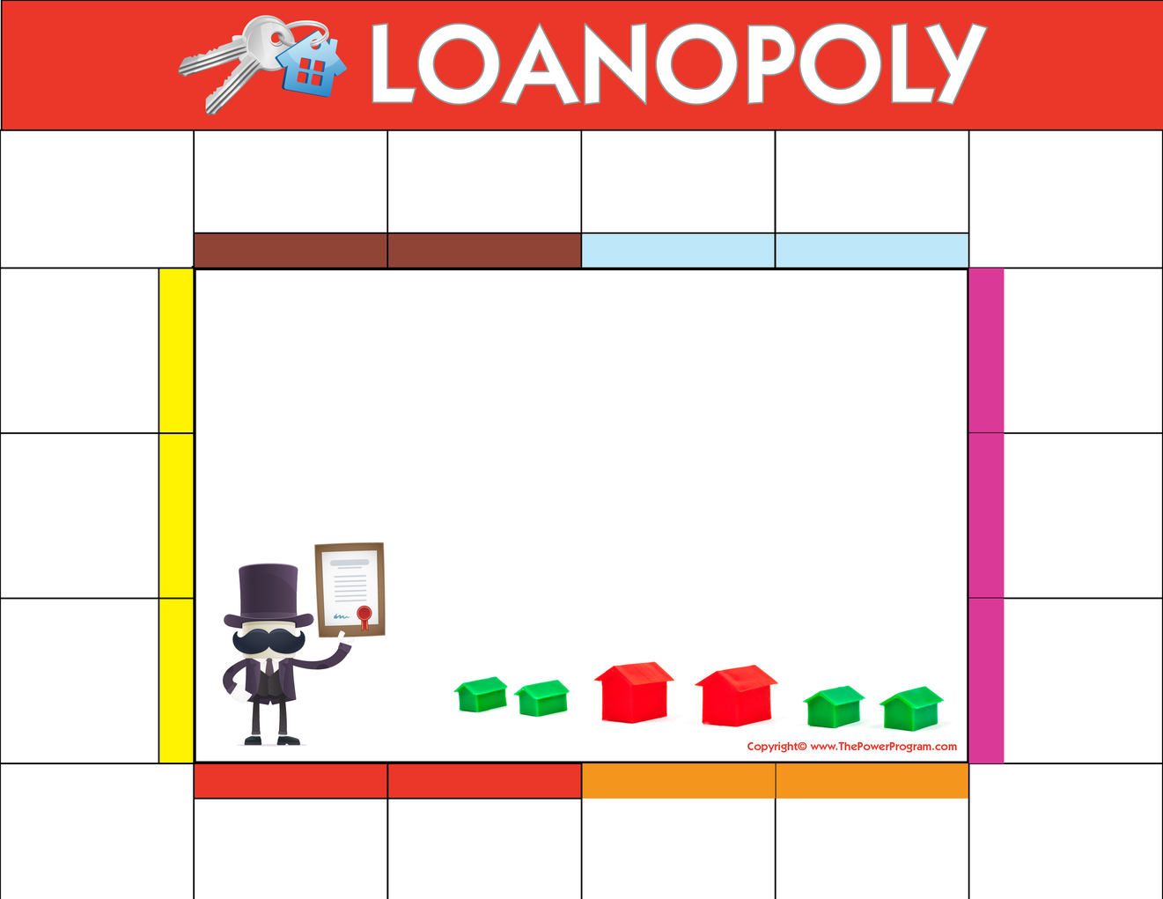



The Buyopoly board simplifies the home-buying process into a fun, engaging game-like experience. Imagine playing Monopoly, but instead of buying properties with fake money, you're navigating through the real steps of buying a home. It starts with the basics—like getting pre-approved for a mortgage—and moves through finding the right home, making an offer, and closing the deal. Each square on the Buyopoly board represents a step in the journey of buying a home. It's a fun way to demystify the complexities of real estate transactions, making it less stressful for you because you can visually see what's coming next and prepare accordingly.
START HERE
PRE-APPROVAL
FIND A HOME
MAKE AN OFFER
APPLICATION PROCESS
CONTRACT-AGREEMENT OF SALE
Preliminary docs include: W2’s, bank statements, tax returns.
Access your wants and needs, then let your REALTOR® help you find a home.
Offer accepted, sign binder, schedule home inspection.
Submit updated pre-approval documents prior to obligating yourself to contract. KNOW YOUR NUMBERS.
Review and sign your contract with your REALTOR® and attorney.
FINISH
HELPFUL STRATEGY:
  Save & submit all future pay stubs
  Save & submit all future bank statements (all pages)
  Keep copies of documents submitted to processing
  Continue to pay off debts and loans on time
COMMON MISTAKES:
  Don’t make cash deposits
  Don’t make large purchases on credit cards
  Don’t co-sign loans for anyone
  Don’t change bank accounts
  Don’t apply for new credit
APPRAISAL ORDER
You can enjoy the tax advantages of owning your new home.
Ordered within the first week of contract. Appraisal inspection completed.
CONGRATS!
Your contact information here.
Add name, company, website, email and phone number.
PROCESSING
Congratulations and welcome to your NEW HOME!
Processor completes all updated information, verifications for credit, employment, and assets.
CLOSING!
APPRAISAL REPORT
You’re at the finish LINE! All parties sign closing documents.
Received and reviewed: processor updates items needed for approval. This will be emailed to you within 3 days of receipt.
FINAL WALK THROUGH
HOMEOWNER INS. POLICY
UNDERWRITING
Borrowers do a final walk-through of the property to approve condition of the house prior to signing closing documents.
CLEAR TO CLOSE
TITLE REPORT
COMMITMENT
Processor submits your file to underwriting for review and commitment letter. Approval commitment letter sent to you and attorney for review.
You are notified that your file is clear to close and a closing date is coordinated and scheduled by all parties.
Copy of appraisal & mortgage clause provided to you for securing homeowner’s insurance.
Title report submitted for review and clearance.
Submit ALL outstanding condition items from commitment letter order to final clearance.
Name here • Phone Number • Website Address • Email • Page 38

Slide 38


LOOK AT HOMES!
Now that you've worked out your “must-have" and “nice-to-have" lists and have considered your personal needs when it comes to your next home, it’s time to start searching for your home! Your real estate agent will have information about the local housing market and will know what to look for when you view the homes, whether in person or virtually.
The timeframe of your purchase can also be a key part of the buying process. If you need to move quickly, finding a home that will be available immediately is vital and may limit the homes you tour. However, if you have a longer timeframe to work with, you can be patient and look for a home that will be perfect for you.
Name here • Phone Number • Website Address • Email • Page 39

Slide 39

THINGS TO THINK ABOUT WHEN CONSIDERING A HOME
Every house has its pros and cons, but there are several things to think about when considering each as a possible home:
  What is the overall condition of the home? Are there any safety concerns? If you have small children, can you fit safety gates at the stairs? Are the locks on doors and windows in good condition?
  How is the home’s functionality? A certain home might be perfect at this point in your life, but what about 5 years from now? Are you planning to have a family? Will you be empty nesters? Do you think about renting out a room, or possibly working from home? Is there lots of storage space?
  What is the home’s location like? Is there a park close by? How far away is the grocery store? Restaurants? Are you close to your workplace? Are you near a main road to hear traffic and sirens going by?
VIRTUAL HOME VIEWING
Many real estate agents can use Facetime or Zoom to show homes now or use pre-recorded videos, 3D walkthroughs, or interactive floorplans to show each home in case an in-person visit isn’t an option. Realtor®.com now has integrated a livestream mode to accommodate virtual open houses and make them available to all.
Name here • Phone Number • Website Address • Email • Page 40

Slide 40




EXPLORE THE NEIGHBORHOODS
    Drive or walk through areas at different times of the day, during the week, and on weekends.
    Travel to and from places that you would typically frequent. Look for access to major thoroughfares, highways, and shopping.
    Check with local civic, police, fire, and school officials to find information about the area.
    Look at traffic access patterns around the area during different times of the day and drive from the area to work.
    Is the neighborhood near parks, places of worship, recreation centers, shopping, theaters, restaurants, public transportation, schools, etc.?
Name here • Phone Number • Website Address • Email • Page 41

Slide 41
TYPES OF MORTGAGE LOANS
Financing is one of the big concerns that buyers have, so below is a chart outlining various mortgage loan types to help you choose the best option for your home purchase. Each loan type offers different features, benefits, and eligibility requirements, catering to a range of financial situations and home-buying goals. Use this chart to compare your options and determine which mortgage loan aligns best with your needs and circumstances.
 | WHO QUALIFIES | DOWN PAYMENT | UPFRONT MORTGAGE INSURANCE | MONTHLY MORTGAGE INSURANCE | MINIMUM CREDIT SCORE
VA Department of Veteran Affairs | Veterans, Personnel with honorable discharge, Reservists & National Guard, Surviving Spouses | NONE | NONE | NONE | 580
USDA Department of Agriculture | Someone who is buying a home in a USDA -designated rural area. | NONE | 2% of the loan amount. Can be rolled into loan amount. | REQUIRED | 640
FHA Federal Housing Administration | Anyone who meets the minimum credit and income levels. | At least 3.5% of purchase price | 1.75% of loan amount | REQUIRED | 580-640
203K Federal Housing Administration | Anyone who plans to purchase a fixer-upper or needs to renovate their home and meets credit & income requirements | At least 3.5% of purchase price | 1.75% of loan amount | REQUIRED | 580-640
CONVENTIONAL 97 | Depending on the program, available first time home buyers (a buyer who hasn't owned in the last three years) can put 3% down with a Conventional 97 program. | Varies from 3%-20% of purchase price | NONE | REQUIRED | 620
SELECT SMART PLUS | Anyone who meets lenders credit, income & debt level requirements | Varies from 3% -20%, but typically ranges from 5-20% | NONE | REQUIRED | 620
Name here • Phone Number • Website Address • Email • Page 42

Slide 42

LOAN APPLICATION CHECKLIST
u
u
u
u
u
u
u
u
u
u
u
u
u
u
u
u
u
u
u
u
u
u
u
u
u
u
u
u
Real estate contract with legal description and deposit receipt.
Check for appraisal and credit report, varies with lender.
Name and complete address of last two years of residence.
Name and complete address of landlord or mortgage company for the last two years.
Explanation letter regarding any employment gaps over the last two years.
Name and address of employers from the last two years with dates.
Explanation letter of any credit deficiencies.
Social Security Numbers of all borrowers.
Current gross monthly income figures.
Copy of paystubs covering a 30-day period and last two years W2s and or 1099s.
If income is derived from other sources, two years tax returns, both business and personal with all schedules, signed.
If self-employed, what is the current profit and loss on income and expenses?
If divorced, a copy of the complete recorded decree and settlement.
Name, address, and account numbers of all places where assets are held (checking, savings, CD’s, IRA’s, etc.) 3 month’s of most current statements.
List of stocks and securities with market value – certified copies.
Estimate of cash value of life insurance.
Schedule of real estate owned, with value, lien, rental income, and payments.
Year, make, and model of vehicles.
Estimate the value of furniture and personal property.
Name, address, numbers, balance, and payments of installment loans
If child support is being paid, provide proof of payment.
If relocating, information regarding a buy-out of house, payment of closing costs, etc. from the company.
If selling current house, a copy of the listing agreement or contract.
Homeowner’s Insurance documentation.
Additional Requirements for FHA/VA Loan Applications
Copy of Driver’s License and Social Security Cards
Name and address of nearest living relative.
Copy of DD214 and/or original Certificate of Eligibility (VA only).
Childcare expenses must be provided.
Name here • Phone Number • Website Address • Email • Page 43

Slide 43

MAKE AN OFFER ON THE HOME OF YOUR CHOICE
You may have looked a LOT of homes, or maybe you found The One right away. Once you have picked the house of your dreams, you’ll be ready to make an offer!
Your real estate agent will help you write up the offer, including the sales price and clauses and taking the items below into consideration. Then, they will act as your advocate and present your offer, representing your interests to the other party.
NEGOTIATE THE DETAILS WITH THE SELLER OR SELLER’S AGENT
Once the seller views your offer, they will very likely prepare a counteroffer. With the help of your expert negotiator real estate agent, the parties will go back and forth until both sides accept the offer. During this process, your real estate agent will offer insights and suggestions on how to proceed. Once all parties have agreed to the price, terms and conditions, you will enter in to contract!
Name here • Phone Number • Website Address • Email • Page 44

Slide 44

WHAT TO INCLUDE IN THE OFFER TO MAKE IT MORE APPEALING
Pre-Approval Letter: Include a mortgage pre-approval letter to show you're financially capable of purchasing the home.
Consider Sellers Circumstances: Find out what is important to the seller and be sure to take their desires into account when making your offer.
Flexible Closing Date: Being flexible with the closing date can be attractive to the seller, especially if they need time to move out.
Higher Earnest Money Deposit: A higher deposit can show your serious commitment to the purchase.
Minimal Contingencies: Fewer contingencies make the process smoother for the seller. However, don't waive essential ones like the home inspection if at all possible.
Shorten Time Periods: Don’t feel comfortable waiving a contingency, consider shortening the time frames to give the seller more confidence.
Cover Some Seller Costs: Offering to pay for some of the seller’s closing costs can make your offer stand out.
Personal Letter: Consider including a personal letter expressing why you love the home. This can resonate with the seller, especially in competitive markets. Make sure you keep it generic and don’t break fair housing laws (I’ll guide you).
Escalation Clause: In a competitive market, an escalation clause can automatically increase your offer if there are higher bids, up to a maximum amount.
Rent-Back Agreement: If the seller needs time to find a new home, offering a rent-back agreement can be appealing.
Name here • Phone Number • Website Address • Email • Page 45

Slide 45



AFTER YOU SUBMIT
AN OFFER
Accept the Offer
Congratulations, we did it!
Reject the Offer
This stops the negotiation process.
The
Seller
Could:
If an offer Isn't accepted or formally rejected by the expiration time, then the offer expires and no longer valid.
Let the Offer Expire
Accept Another Offer
The seller can accept another buyer’s offer and may not give you the opportunity to revise your offer.
Counter the Offer
The seller can come back with different terms or a price in an attempt to negotiate terms acceptable to both parties.
You Can Then:
Accept Counteroffer
Decline Counteroffer
Counter their Counteroffer
Congratulations,
we did it!
This stops the
negotiation process.
Negotiations can go back and forth multiple times until an agreement is made, or the inability to come to an agreement.*
* NOTE: while in the negotiation process, another offer could come in and the seller could accept a different offer. During the negotiation process, it’s vital to keep response times as short as possible to minimize that risk.
OFFER ACCEPTED
Congratulations, you are now in contract! You and your agent will begin moving through any contingencies that are outlined in your purchase agreement.
Name here • Phone Number • Website Address • Email • Page 46

Slide 46

PURCHASING AND CLOSING THE DEAL
Your offer was finally accepted by the seller, and you now move into the final phase of the home-buying process!
Homebuyers everywhere probably consider this the most stressful part. By the time the deal is done, you will have signed what feels like a thousand documents.
Name here • Phone Number • Website Address • Email • Page 47

Slide 47

HAVE YOUR HOME INSPECTION AND APPRAISAL DONE
Typically, a thorough home inspection and an appraisal will be done for the home you are looking to purchase, especially if you are financing. This is a great way for you to protect your interests and learn if there are any problems with the home you put an offer in on, and can give you some negotiating power in your offer.
Appraisals are scheduled by your lender. These can be a simple exterior drive-by, using pictures or video walk-throughs for their assessments, or in other cases, a more thorough physical appraisal is done.
If you are purchasing a resale property, we highly recommend that you have a professional home inspector conduct a thorough inspection. The inspection will include, but may not be limited to, the following:
    Appliances
    Plumbing
    Electrical
    Air conditioning and heating
    Ventilation
    Roof and Attic
    Foundation
    General Structure
Name here • Phone Number • Website Address • Email • Page 48

Slide 48

The inspection is not designed to criticize every minor problem or defect in the home. It is intended to report on major damage or serious problems that require repair. Should serious problems be indicated, the inspector will recommend that a structural engineer or some other professional inspect it, as well.
A home cannot “pass or fail” an inspection, and your inspector should not tell you whether he/she thinks the home is worth the money you are offering. The inspector’s job is to make you aware of repairs that are recommended or necessary so that you can continue to make an informed decision.
The seller may be willing to negotiate the completion of repairs or a credit for the completion of repairs, or you may decide that the home will take too much work and money. A professional inspection will help you make a clear-headed decision. In addition to the overall inspection, you may wish to have separate tests conducted for termites or the presence of radon gas.
In choosing a home inspector, consider one that has been certified as a qualified and experienced member by a trade association. Your buyer’s agent can recommend several professional home inspectors for you to consider, and they will attend the inspection, as should you.
Hire an inspector who is familiar with the type of property you intend to purchase and its immediate surroundings. They can help explain their findings so you’ll be able to clearly understand the inspection report and know exactly which areas need attention. Plus, you can get answers to many questions, tips for maintenance, and a lot of general information that will help you once you move into your new home. Most importantly, you will see the home through the eyes of another objective third party.
Name here • Phone Number • Website Address • Email • Page 49

Slide 49

SECURE YOUR FINANCING
Since you’ve already seen your lender for pre-approval, it’s now a matter of securing the funds for the sales amount agreed upon. You will finalize the details like the down payment, the interest rate, and the payment schedule, and sign the papers.
UNDERSTAND THE CLOSING COSTS
One thing that every homebuyer needs to be aware of, especially first-time buyers, are the closing costs. Typically, this works out to about 3 -4 % of the cost of the home you are purchasing. For example, a $400,000 home would have approximately $12,000 to $16,000 in closing costs.
These are the things that need to be paid by the buyer:
  Home inspection
  Property appraisal
  Property survey
  Deposit (down payment)
  Title insurance
  Property insurance
  Land transfer tax
  State recording fees
  Property taxes, Utilities, and condo fees
  Mortgage default insurance
  Escrow fees
  Legal fees and disbursements
  New home warranties
  Moving costs
If you hire an agent to represent you and your best interest, that is often referred to as a buyer's agent. In this scenario, you would be responsible for your agent getting paid their fee. This doesn’t necessarily mean that you would cut a check directly to your agent, although that’s an option. Usually, it can be worked on and negotiated when presenting the offer to the seller. Because this is something that is based on license law and state guidelines, ask your agent to explain how they plan on getting paid their fee.
Name here • Phone Number • Website Address • Email • Page 50

Slide 50


THE OFFICIAL CLOSING
This meeting will typically be at the lender’s (or lender’s attorney’s) office. In some states, a real estate transaction is not officially closed until the documents are recorded at the local records office. Other states simply consider the deal closed when the documents are signed and the money changes hands. A lot of documents need to be signed by several institutions.
CELEBRATE AND MOVE IN!
You’ve done it! You’ve bought your dream home, and all that is left is moving in! On the day you get possession of your new home, you will meet with your real estate agent for a final walk-through of your new home.
After the walkthrough is completed, you will get the keys and discuss any final issues with your agent. Then, you will be free to start moving in!
Name here • Phone Number • Website Address • Email • Page 51

Slide 51

MOVING CHECKLIST
One Month Prior
u
u
u
u
u
u
u
u
File “Change of Address” forms with the postal service
Make arrangements to move your personal belongings and furniture, either by phoning a moving company or arranging for a rental truck.
Gather boxes and other moving supplies that you might need.
Plan your travel route to your new home. Be mindful of any bridges or overpasses that might have a clearance restriction.
Create a folder to keep moving expense receipts, as some of these are tax deductible. Lodging, meals, and fuel are some of the items you can claim on your taxes.
Develop a plan for packing – packing the things you will use most, pack last, then ensuring those items that you will need first when you arrive at your new home will be available.
Notify family, friends, and businesses of your move.
Notify federal and state tax authorities, as well as any other government agencies.
Name here • Phone Number • Website Address • Email • Page 52

Slide 52

MOVING CHECKLIST
Two Weeks Prior
u
u
u
u
u
u
u
u
Notify services like gas, electric, water, cable TV, phone, and internet of your move.
Arrange for services at your new address.
Have your car serviced if your new home is some distance away.
Recruit people to help you on moving day.
Have a detailed plan for keeping pets safe at all times once the movers arrive. This can be a very stressful time for them as well, with strangers in the house, loud noises, a lot of activity, and doors being open for long periods of time.
Arrange for babysitters for any small children.
Confirm your moving company or rental truck arrangements.
Notify your bank if you are leaving the city.
Name here • Phone Number • Website Address • Email • Page 53

Slide 53

MOVING CHECKLIST
One Day Prior
u
u
u
u
Keep moving materials separate so they don’t accidentally get packed until you are done.
Put your phone chargers in a safe place to keep handy.
Pick up a rental truck if you are moving yourself.
Fill up your car with gas, and double-check your oil and tire pressure.
Get a good sleep!
On Moving Day
u
u
u
u
Have the proper moving supplies handy, such as undamaged boxes to finish packing, blankets for TV’s, mirrors, and pictures, and tie-down straps to prevent large items from shifting during the drive.
Do a final walk-through to make sure you have everything!
Pack the “Essentials” box. This will be the box you open first at your new home, and will have phone chargers, personal hygiene items, pet food, snacks, bottled water etc. Everything you will need to keep handy as you move into your new place.
Do a walk-through of your new home and take pictures, checking for any damage that wasn’t there when you purchased.
Name here • Phone Number • Website Address • Email • Page 54

Slide 54

MOVING CHECKLIST
After the Move
u
u
u
u
u
u
u
u
Make sure that any mail that arrives with a yellow sticker (this indicates it was forwarded) is contacted and given your new address.
Register to vote in your new area.
Get the address on your driver’s license changed to your current address. If you have moved to a different state, you will need to apply for a new one.
Contact auto insurance to have the policy changed to your new address.
Find out when the garbage is picked up at your new home and what recycling programs are available.
Select a new doctor, dentist, chiropractor, optometrist, etc., and have your medical files transferred.
Locate new service providers such as banks, pharmacies, plumbers, HVAC contractors, etc.
Make a list of the new emergency numbers to have handy in your new home.
Name here • Phone Number • Website Address • Email • Page 55

Slide 55




TIPS FOR HELPING CHILDREN WITH A MOVE
Kids require extra attention and care when planning to buy or sell a home. Making a little extra effort to include them in the buying and selling process helps them adjust more quickly to the move.
u
u
u
Show the children the new home prior to moving. If this isn’t possible, pictures or videos will help them visualize where they are going.
Assure children that you won’t forget their friends.
Make a scrapbook of the old home and neighborhood.
Throw a good-bye party. At the party, have their friends sign a t-shirt.
Have your children write goodbye letters to their friends and enclose their new address. You may wish to call the other children’s parents so they will encourage return letters.
When packing, give them their own box. They can decorate it so they will know which one is theirs after the move.
If you are moving far away, buy postcards when you stop so they can remember the trip.
When unpacking, allow them to unpack their treasures then, and have them play with the boxes while you unpack.
Start a scrapbook for their new home, including a diary of My First…
Visit their new school, park, church, etc. Take a camera to snap pictures for the scrapbook.
Help your children invite new friends over to the house.
Let them choose a new favorite restaurant. This will help them feel in control of their new world.
Encourage them to send letters about their new home to their friends.
Involve your children in groups, sports, and activities like the ones they used to participate in.
Remember that even if you only lived in your former home a few years, to a young child it is nearly their entire life!
u
u
u
u
u
u
u
u
u
u
u
u
Name here • Phone Number • Website Address • Email • Page 56

Slide 56
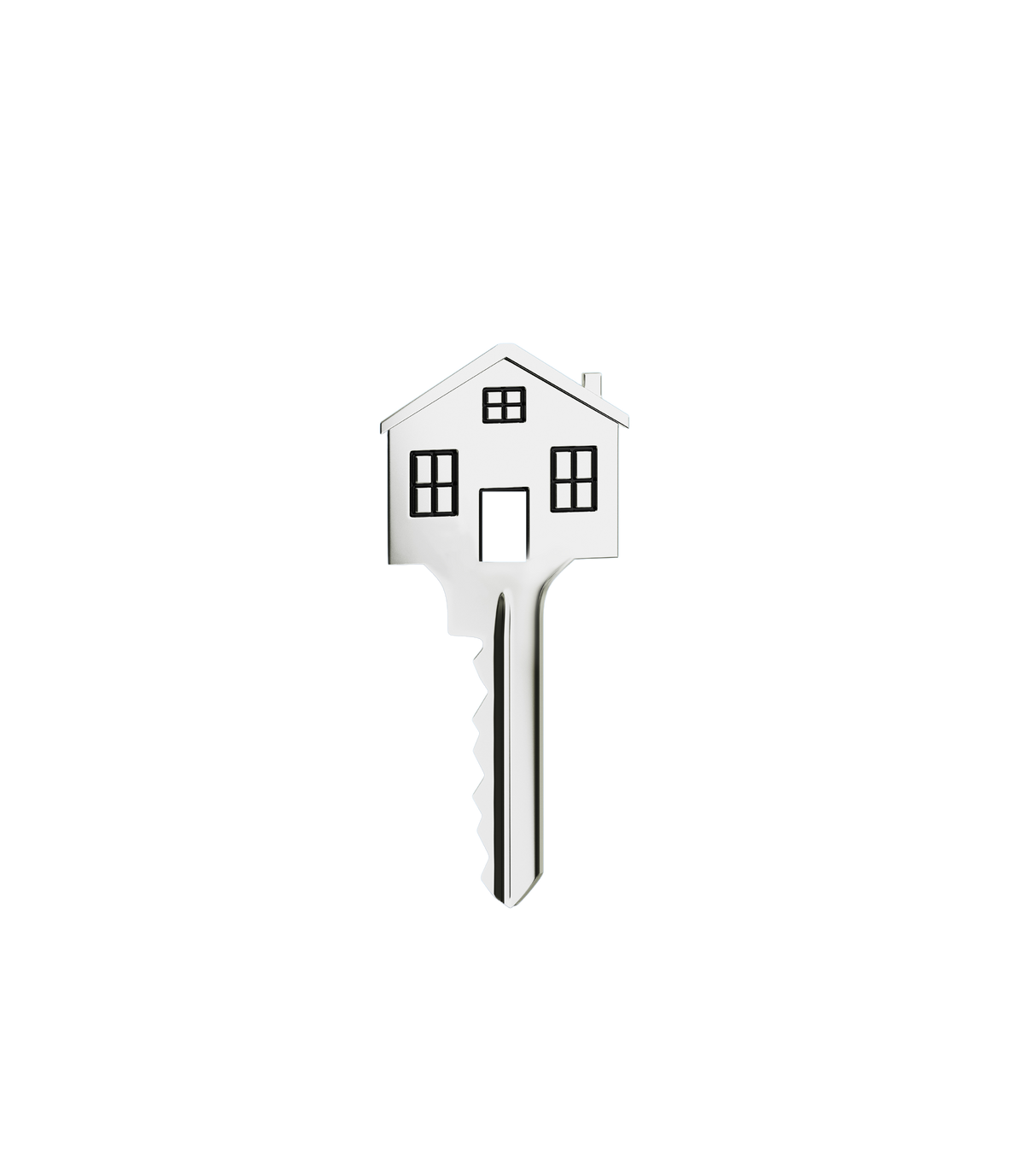
MY COMMITMENT TO YOU,
The Buyer
While the closing on your new home may mark the end of the purchase process, I hope it will mark the beginning of an ongoing relationship. I make a concerted effort to keep in touch with my clients and to continue to be a resource for their real estate and neighborhood needs.
As a client, you can look forward to receiving periodic updates on neighborhood events and quarterly real estate market analysis reports. And, of course, if you need referrals for plumbers, electricians, and other service professionals, I am always happy to provide you with a list of trusted vendors. I am committed to being a trusted resource you can count on to help you expertly navigate any real estate question or need.
My goal is your goal, and I want to help you move up to your Next Level in life, whatever that might be.
Maintaining relationships is part of my commitment to provide a level of real estate service well above and beyond expectations. My clients share their positive experience with friends and associates who then seek me out. This has allowed me to build a successful real estate practice based on referrals.
As a result, I can devote more of my time to helping clients and spend less looking for new ones. If you are happy with my service, I hope you will spread the word and send people my way so I can help them the same way I helped you. That’s a win-win all around!
Thank you for the privilege!
Name here • Phone Number • Website Address • Email • Page 57

Slide 57


TESTIMONIALS FROM REAL BUYERS
Your testimonial here. Your testimonial here. Your testimonial here. Your testimonial here. Your testimonial here. Your testimonial here. Your testimonial here. Your testimonial here. Your testimonial here. Your testimonial here. Your testimonial here. Your testimonial here. Your testimonial here. Your testimonial here. Your testimonial here. Your testimonial here. Your testimonial here. Your testimonial here. Your testimonial here. Your testimonial here. Your testimonial here. Your testimonial here.
Your testimonial here. Your testimonial here. Your testimonial here. Your testimonial here. Your testimonial here. Your testimonial here. Your testimonial here. Your testimonial here. Your testimonial here. Your testimonial here. Your testimonial here. Your testimonial here. Your testimonial here. Your testimonial here. Your testimonial here. Your testimonial here. Your testimonial here. Your testimonial here. Your testimonial here. Your testimonial here. Your testimonial here. Your testimonial here.
Your testimonial here. Your testimonial here. Your testimonial here. Your testimonial here. Your testimonial here. Your testimonial here. Your testimonial here. Your testimonial here. Your testimonial here. Your testimonial here. Your testimonial here. Your testimonial here. Your testimonial here. Your testimonial here. Your testimonial here. Your testimonial here. Your testimonial here. Your testimonial here. Your testimonial here. Your testimonial here. Your testimonial here. Your testimonial here.
Name here • Phone Number • Website Address • Email • Page 58

Slide 58









Find me on Social:
#handle
#handle
#handle
#handle
#handle
Your Name Here
Your title here
This is about YOU. Text here. Text here. Text here. Text here. Text here. Text here. Text here. Text here. Text here. Text here. Text here. Text here. Text here. Text here. Text here. Text here. Text here. Text here. Text here. Text here. Text here. Text here. Text here. Text here. Text here. Text here. Text here. Text here. Text here. Text here. Text here. Text here. Text here. Text here. Text here. Text here.
Office Name • Office Address
Phone Number • Website Address • Email

