Slide 1



TryThePowerProgram.com

Slide 2

THE PREVENTION OF THE….
TryThePowerProgram.com

Slide 3
https://darrylspeaks.com/lets-stay-together-why-buyer-love-letters-deserve-a-second-chance/
TryThePowerProgram.com

Slide 4

Opening Remarks
My goal is to stop the spreading of fake laws on this topic
I am not trying to convince you to use Buyer Love Letters
I may sound bias because I created the Buyer Love Letter in 1993
No Association will tell you it IS AGAINST The LAW
TryThePowerProgram.com

Slide 5
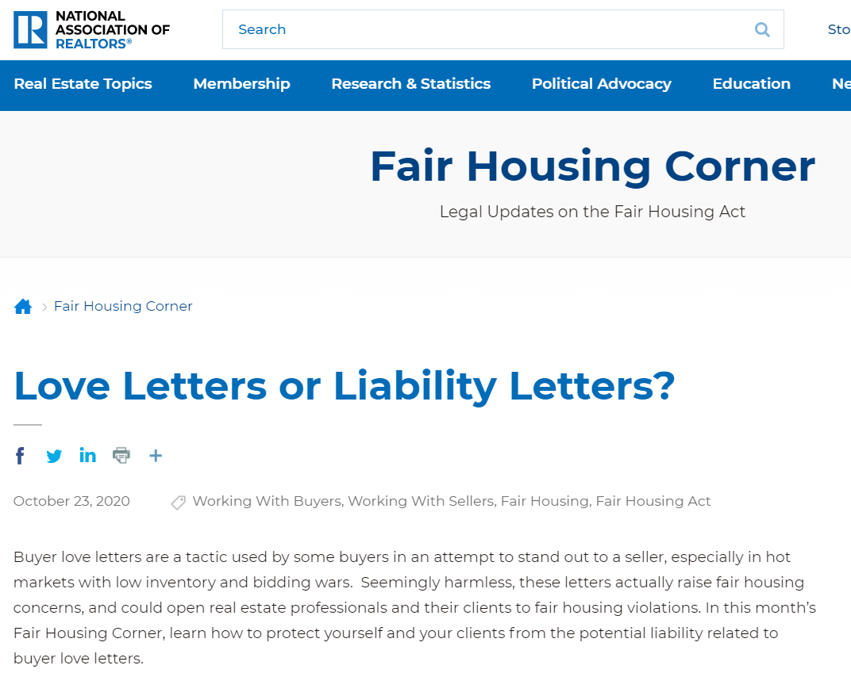
IT IS
IT Will
LIABILITY
COULD
IT HAS
IMPLIED
CONCERNS
VIOLATION
LAWSUIT
DEFINATELY
TryThePowerProgram.com

Slide 6
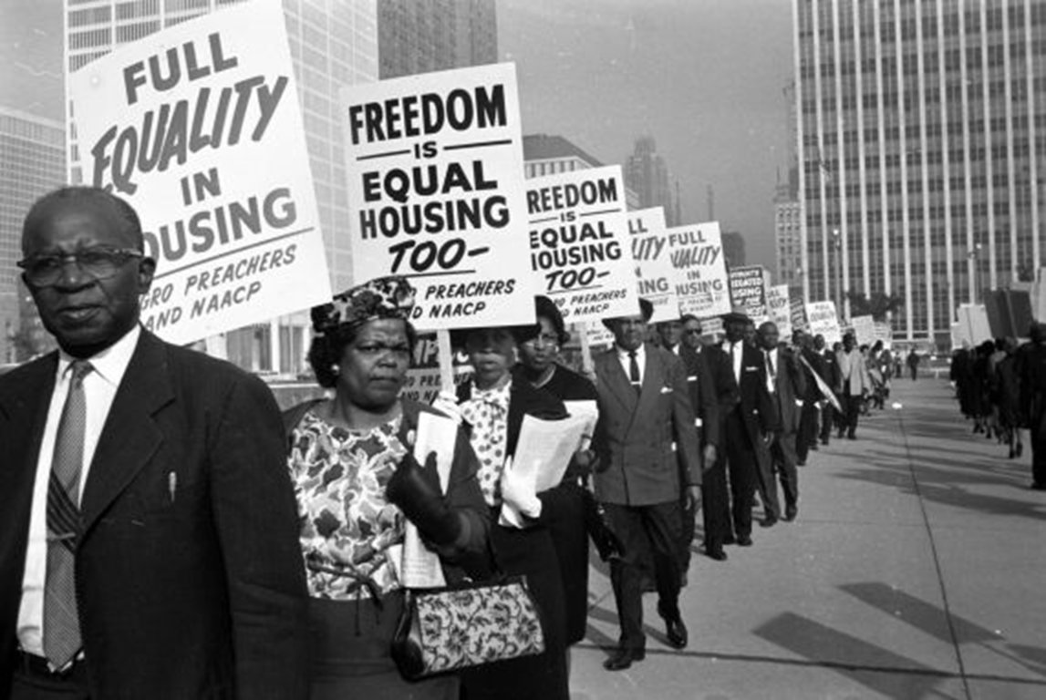
TryThePowerProgram.com

Slide 7

A Rule is Not a Law
Your License Is Governed By Laws, Not Rules
When a Rule Breaks The Law, The Law Wins
TryThePowerProgram.com

Slide 8

In his video Window to the Law, ”The Fair Housing Act makes discrimination illegal in the sale or rental of housing and prohibits making housing otherwise unavailable because of race, color, national origin, religion, sex, disability or familial status. The word “unavailable” is key here. The Fair Housing Act prohibits making housing otherwise unavailable because of race, color, etc.”
Charlie Lee
NAR’s Senior Counsel
TryThePowerProgram.com
Notes:
https://www.nar.realtor/videos/window-to-the-law

Slide 9
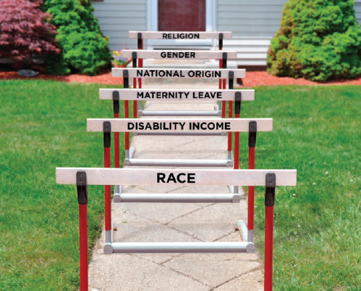
TryThePowerProgram.com
Notes:
https://www.hud.gov/program_offices/fair_housing_equal_opp/fair_housing_act_overview

Slide 10
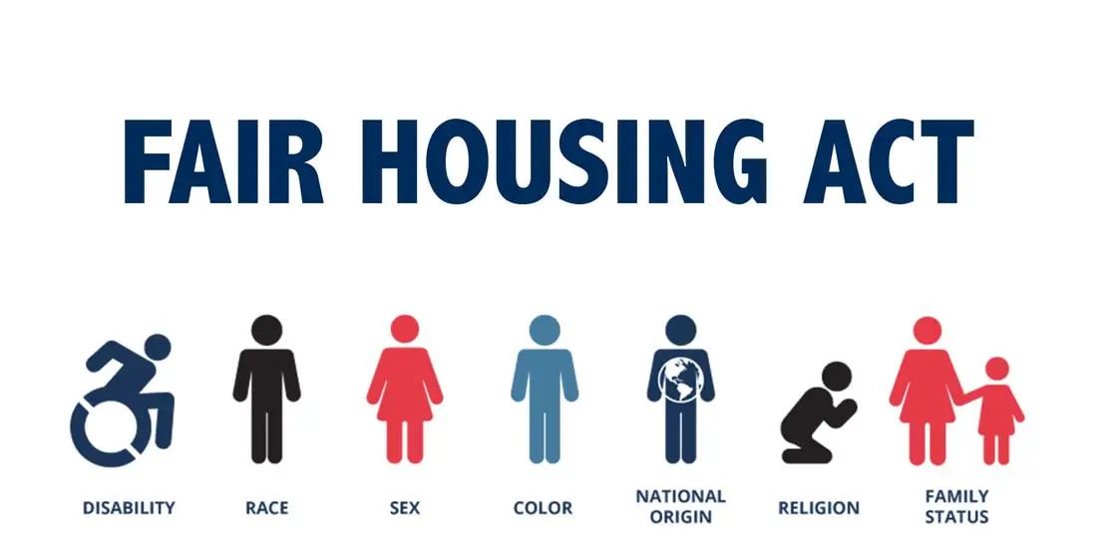
What Is Prohibited?
In the Sale and Rental of Housing:
It is illegal discrimination to take any of the following actions because of race, color, religion, sex (including gender identity and sexual orientation), disability, familial status, or national origin:
Refuse to rent or sell housing
Refuse to negotiate for housing
Otherwise make housing unavailable
Set different terms, conditions or privileges for sale or rental of a dwelling
Provide a person different housing services or facilities
Falsely deny that housing is available for inspection, sale or rental
Make, print or publish any notice, statement or advertisement with respect to the sale or rental of a dwelling that indicates any preference, limitation or discrimination
Impose different sales prices or rental charges for the sale or rental of a dwelling
Use different qualification criteria or applications, or sale or rental standards or procedures, such as income standards, application requirements, application fees, credit analyses, sale or rental approval procedures or other requirements
Evict a tenant or a tenant’s guest
Harass a person
Fail or delay performance of maintenance or repairs
Limit privileges, services or facilities of a dwelling
Discourage the purchase or rental of a dwelling
Assign a person to a particular building or neighborhood or section of a building or neighborhood
For profit, persuade, or try to persuade, homeowners to sell their homes by suggesting that people of a particular protected characteristic are about to move into the neighborhood (blockbusting)
Refuse to provide or discriminate in the terms or conditions of homeowners insurance because of the race, color, religion, sex (including gender identity and sexual orientation), disability, familial status, or national origin of the owner and/or occupants of a dwelling
Deny access to or membership in any multiple listing service or real estate brokers’ organization
For more information and examples, visit Examples of Housing Discrimination.
TryThePowerProgram.com
Notes:
https://www.hud.gov/program_offices/fair_housing_equal_opp/fair_housing_act_overview

Slide 11
An Individual has violated the Fair Housing Act when they DENY someone housing based on their protected class
An Individual has NOT violated the Fair Housing Act when they ACCEPT someone into housing based on their protected class
TryThePowerProgram.com
Notes:
https://www.hud.gov/program_offices/fair_housing_equal_opp/fair_housing_act_overview

Slide 12
Positive Discrimination
Classification | Federal Discrimination
Race
Religion
Sex
Nationality
Disability
Family
TryThePowerProgram.com

Slide 13
Positive Discrimination
Classification | Federal Discrimination
Race | Minority Business Development Agency Hispanic-Serving Institution Funding
Religion | Religious Freedom Grant Program
Sex | SBA Women-Owned Small Business LGBTQ+ Health Incitive
Nationality | 184 Indian Home Loan Guarantee VA Native American DirectLoan Native American Business Development
Disability | SBA Disabled Veteran Owned Small Businesses Social Security Disability Insurance Vocational Rehabilitation Programs Americans with Disabilities Act National Network
Family | FannieMae HomeReady National Homebuyers Fund Housing Voucher Program
TryThePowerProgram.com

Slide 14

TryThePowerProgram.com

Slide 15
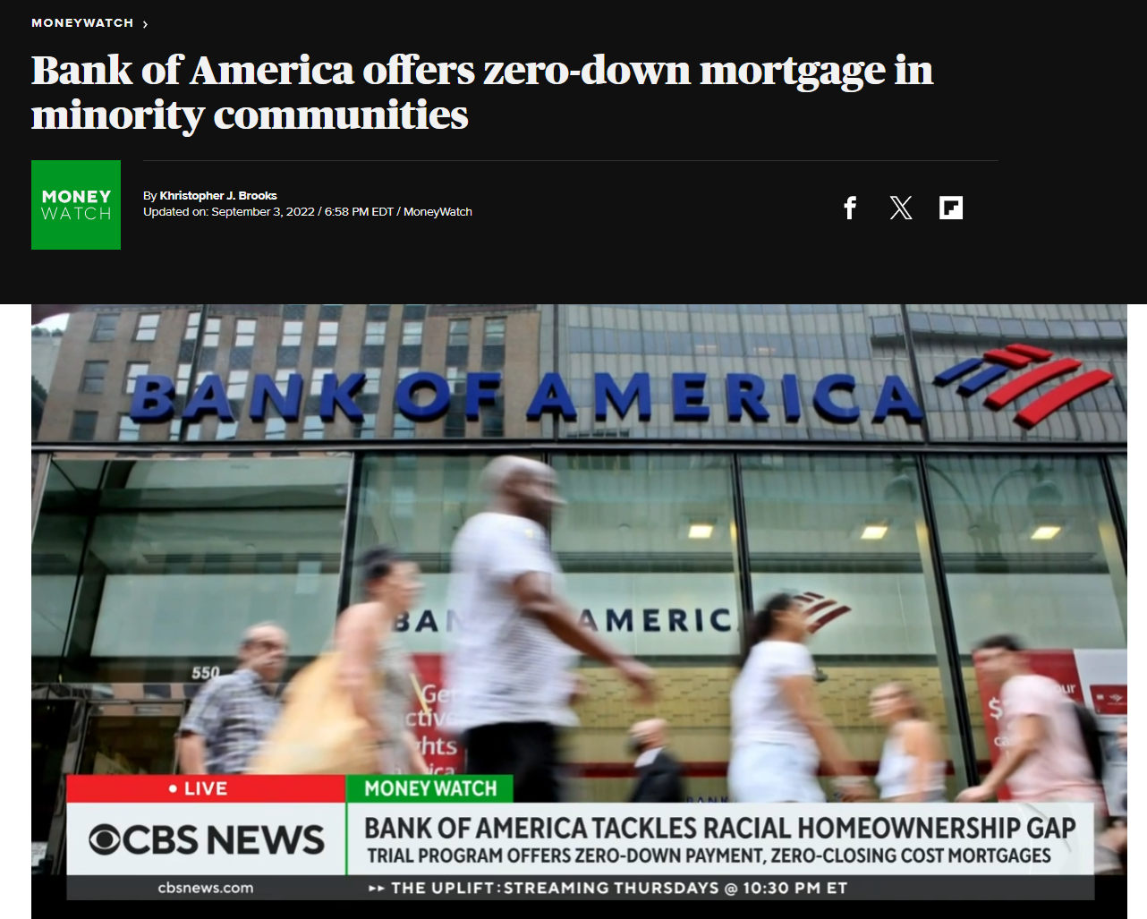
TryThePowerProgram.com

Slide 16
An Individual has violated the Fair Housing Act when they DENY someone housing based on their protected class
An Individual has NOT violated the Fair Housing Act when they ACCEPT someone into housing based on their protected class
TryThePowerProgram.com
Notes:
https://www.hud.gov/program_offices/fair_housing_equal_opp/fair_housing_act_overview

Slide 17

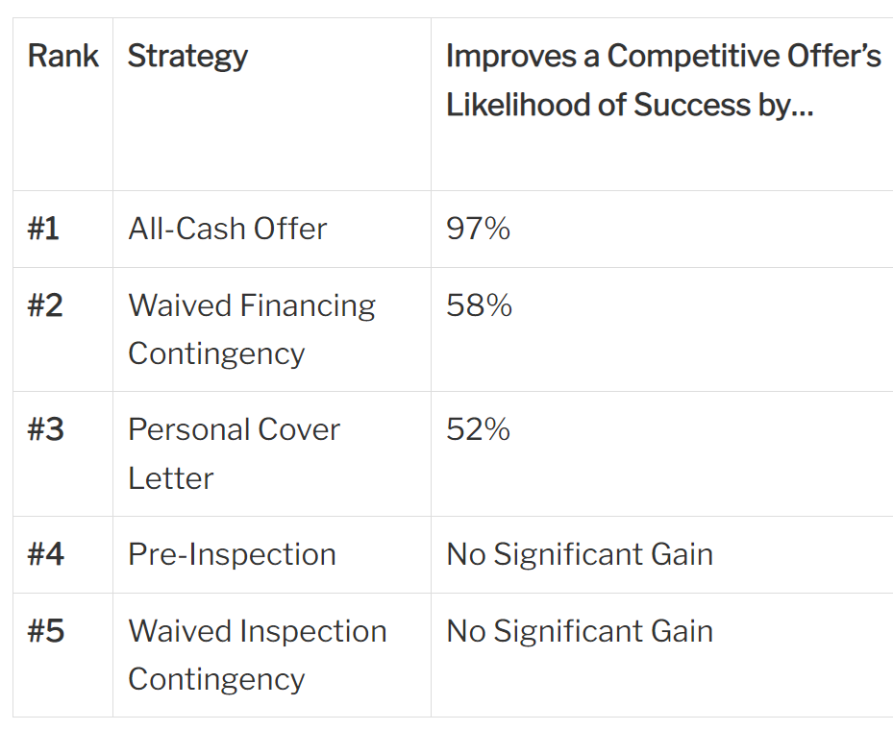
2017 Study
59% - 2019
TryThePowerProgram.com
Notes:
https://www.redfin.com/news/which-bidding-war-strategies-are-most-effective/

Slide 18
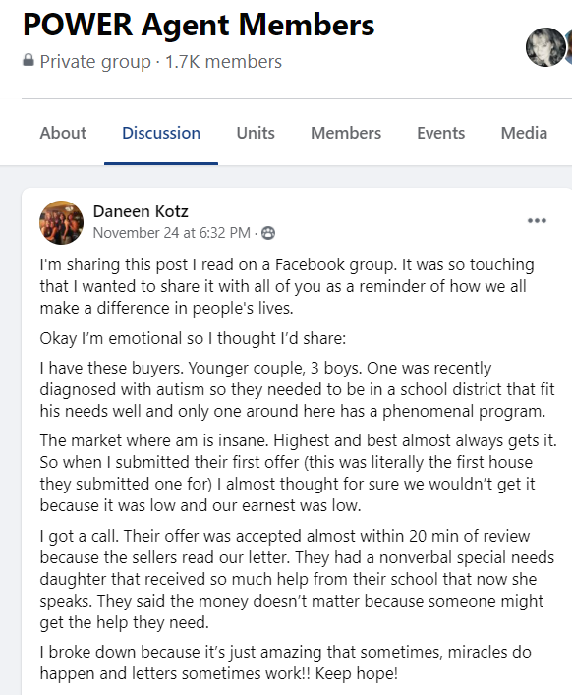
TryThePowerProgram.com

Slide 19

“Recently, a seller chose my clients’ offer, which was $50,000 less than a competing offer, just because he was so moved by the couple’s story. The seller had raised his family in the house and fell in love with the buyers’ letter and the idea of them living in his house.”
TryThePowerProgram.com

Slide 20

Dear Mr. & Mrs. DeWare.
As we present this offer, we’d like to thank you for considering us as buyers for your home. We have looked at many houses, but none of them had the same feeling yours has. Along with meeting our needs as a large family, your home is filled with the love of twenty seven years. We all had the sensation that we were being “hugged” when we walked in. The children, who obviously don’t understand the process of negotiations, have all chosen their bedrooms already! We have, of course, told friends and family about your home and they are keeping all of us in their prayers. For this reason, we feel confident that we can reach an agreement that everyone is comfortable with. No matter what the outcome, we are grateful to have been considered to possibly be the next family to be raised in the warmth of your home.
Sincerely,
The Robinson Family

Slide 21

Long Island, New York: The asking price was $215,000 and the listing agent said the homeowner will take nothing less than $210,000 because they have already rejected that.
Dear Mrs. O’Keefe,
My children and I visited your house yesterday and were very impressed with your home. I am a recent widow and wanted a home that the children and I would love and make our transition to New York an easier process. I hope we will be able to negotiate the sale so we can be settled as soon as possible.
Thank You,
Maureen Sweeney
The homeowner accepted $198,000.

Slide 22

2 Things to Be Present to Have Fair Housing Violation
It must cost the party something
Proof the owner CHOSE (made a conscious decision) to NOT sell to a buyer based on their classification.
TryThePowerProgram.com

Slide 23
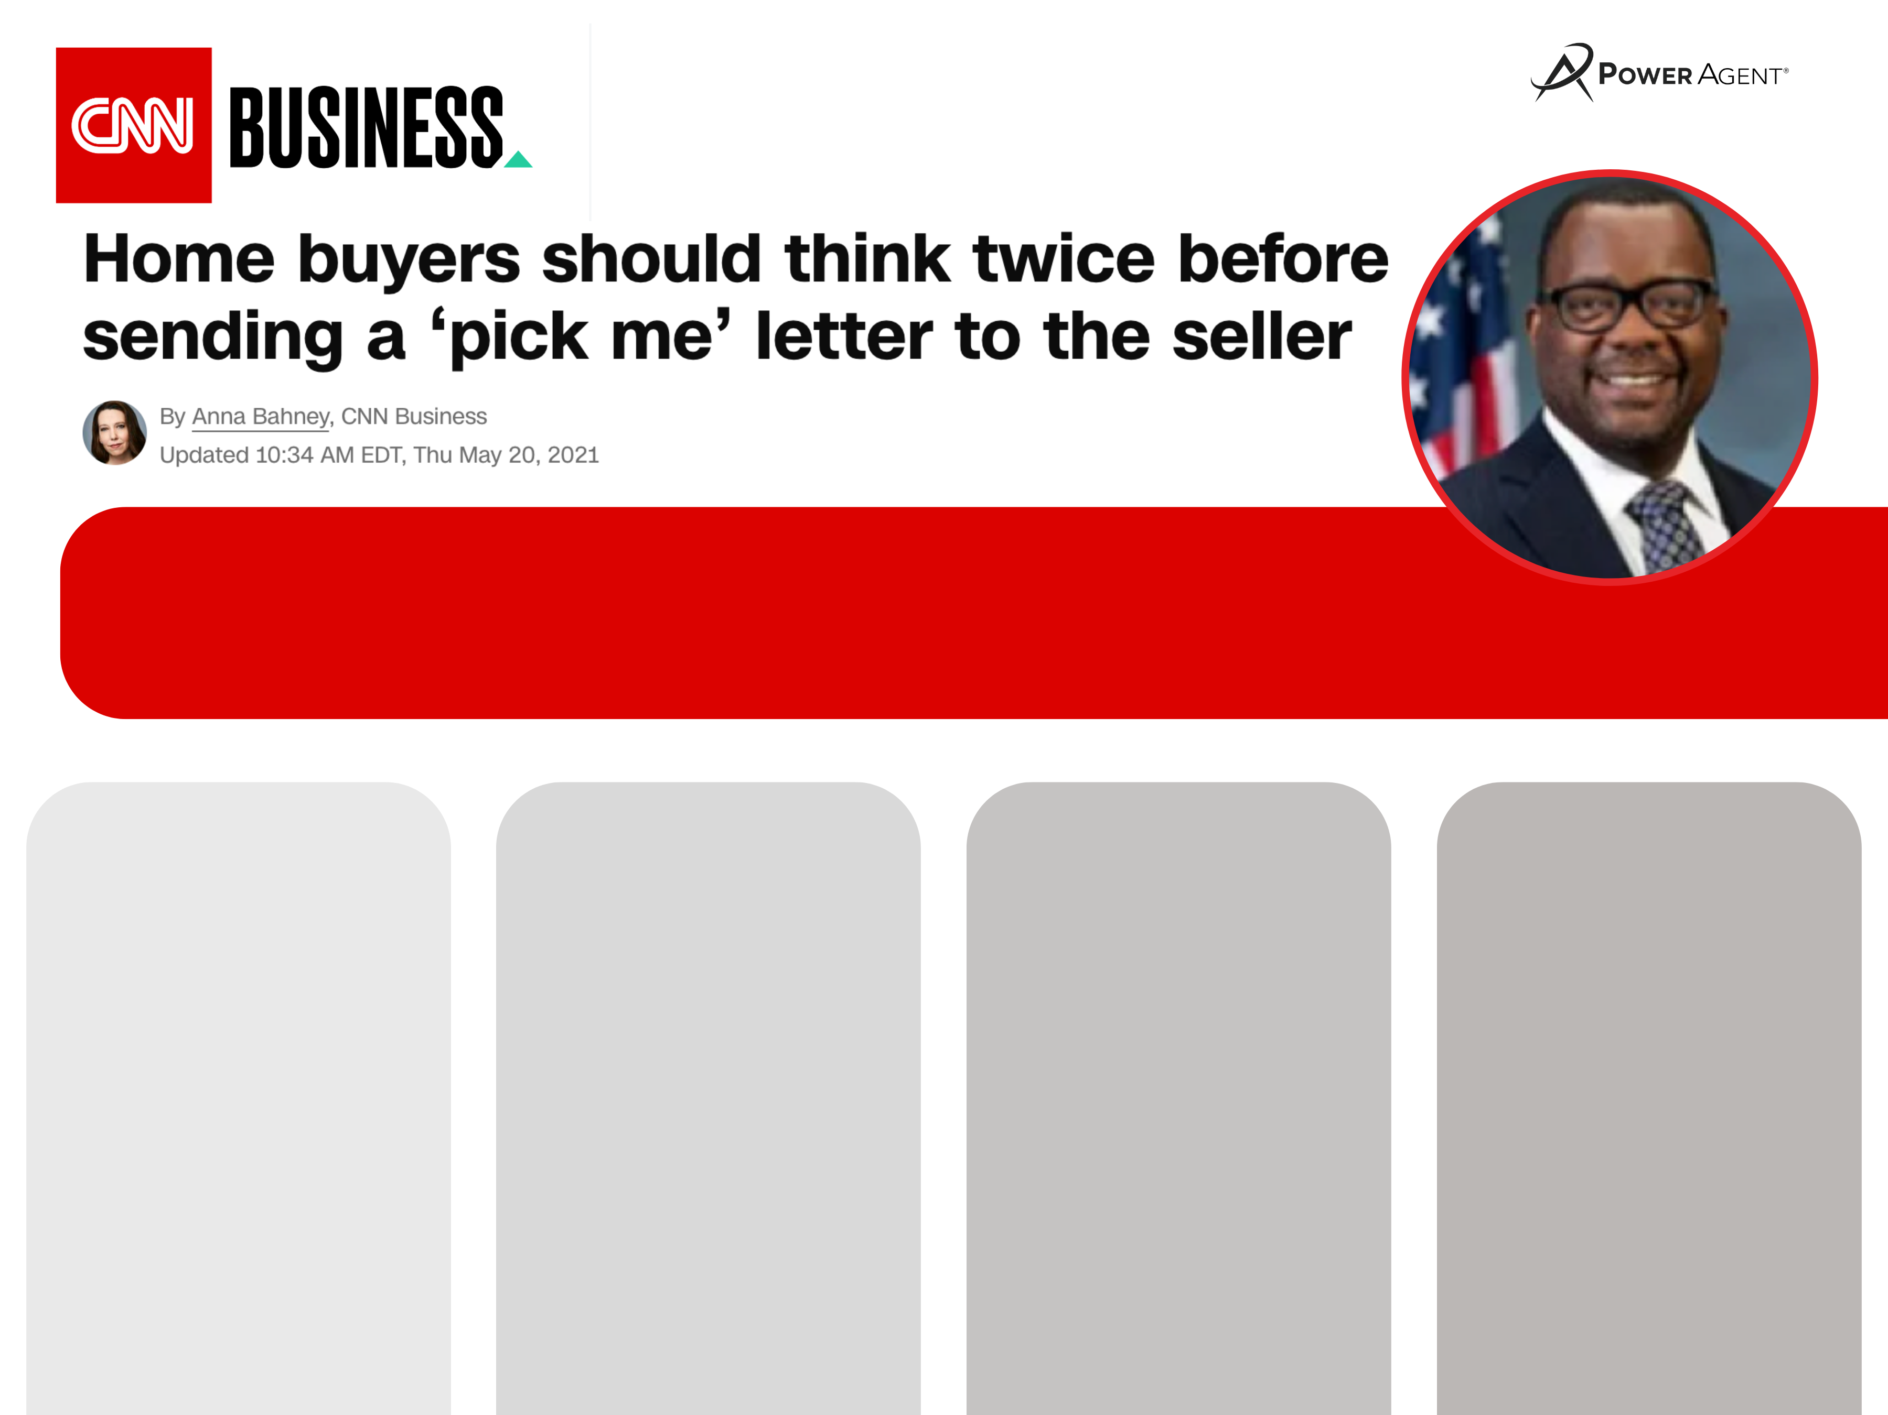
Quotes from Bryan Greene, NAR’s
Vice-President of Policy Advocacy from this interview.
When it comes to a buyer writing a love letter or an agent presenting one, Greene states: “It isn’t a rule and there are no legal consequences for agents who do otherwise.”
“It would be hard to bring a Fair Housing complaint unless you had direct knowledge that a seller made a decision based on a detail about one of the protected classes revealed in one of these letters.”
Greene points out that the liability is mostly theoretical. He is not aware of any actual case that has been brought as a result of a buyer love letter being written and/or read.
“A buyer could suspect they lost because of the letter, but then you’d have to prove that the seller relied on a specific discriminatory aspect of the letter.”
Notes:
https://www.cnn.com/2021/05/19/homes/love-letters-from-home-buyers/index.html

Slide 24
The number of lawsuits based on the “love letter” since 1993 to the present day is:
0
The number of lawsuits based on the “love letter” and First Amendment Right Violation:
1
TryThePowerProgram.com

Slide 25



Price: $510,000
Price: $500,000
TryThePowerProgram.com

Slide 26

Price: $510,000
Price: $500,000
TryThePowerProgram.com

Slide 27
Price: $500,000
Price: $510,000
TryThePowerProgram.com

Slide 28
Price: $500,000
Price: $510,000
TryThePowerProgram.com

Slide 29
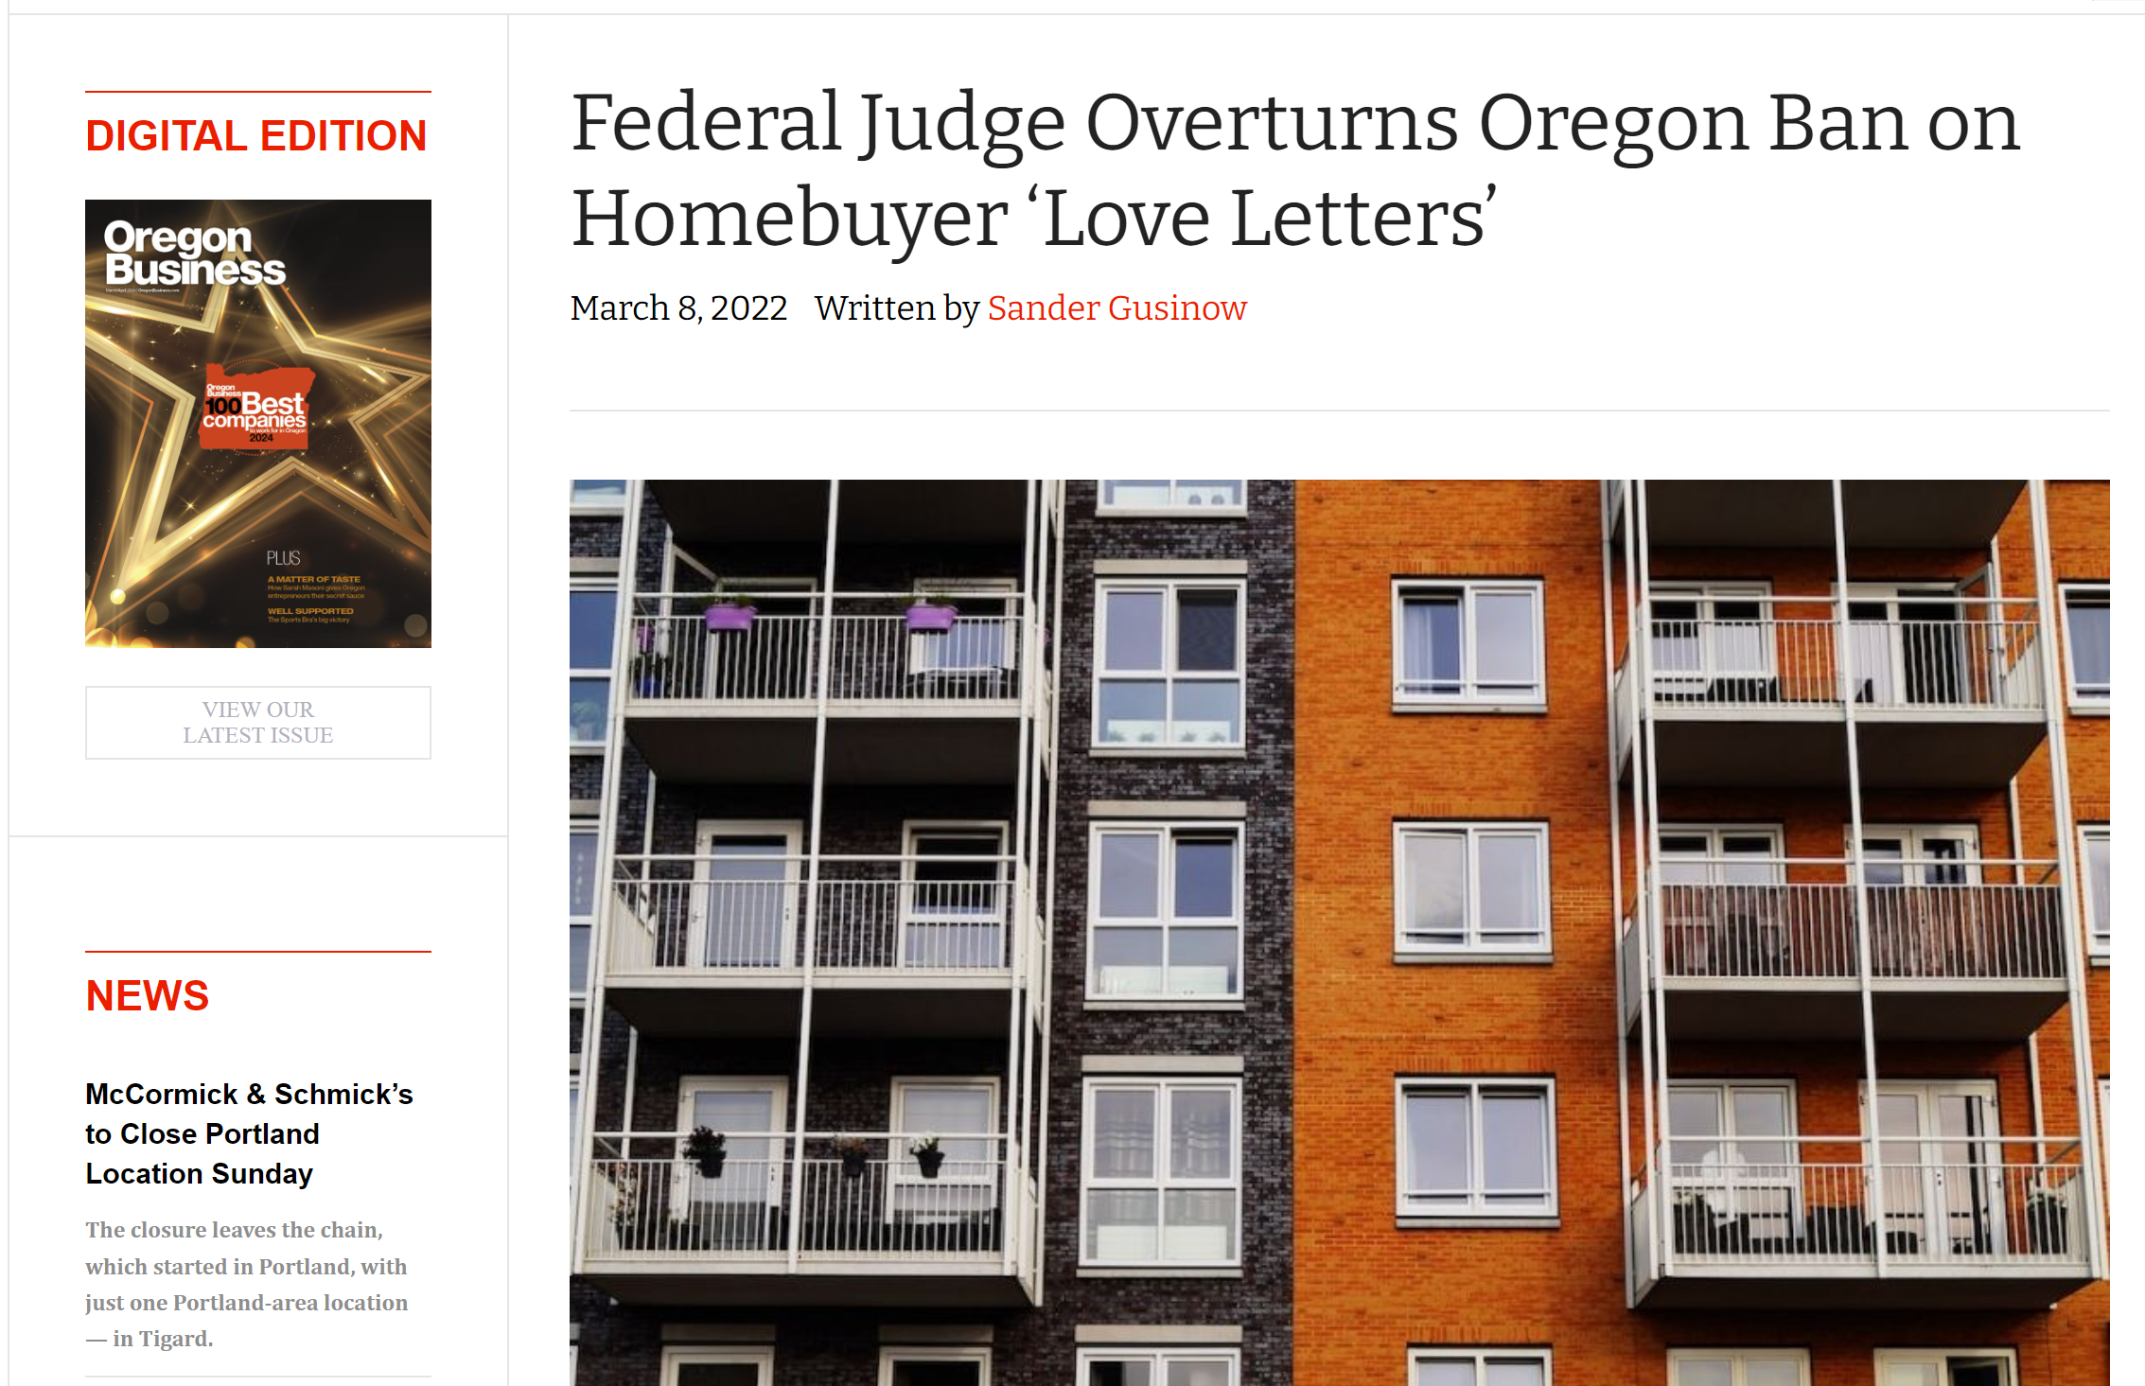

Slide 30
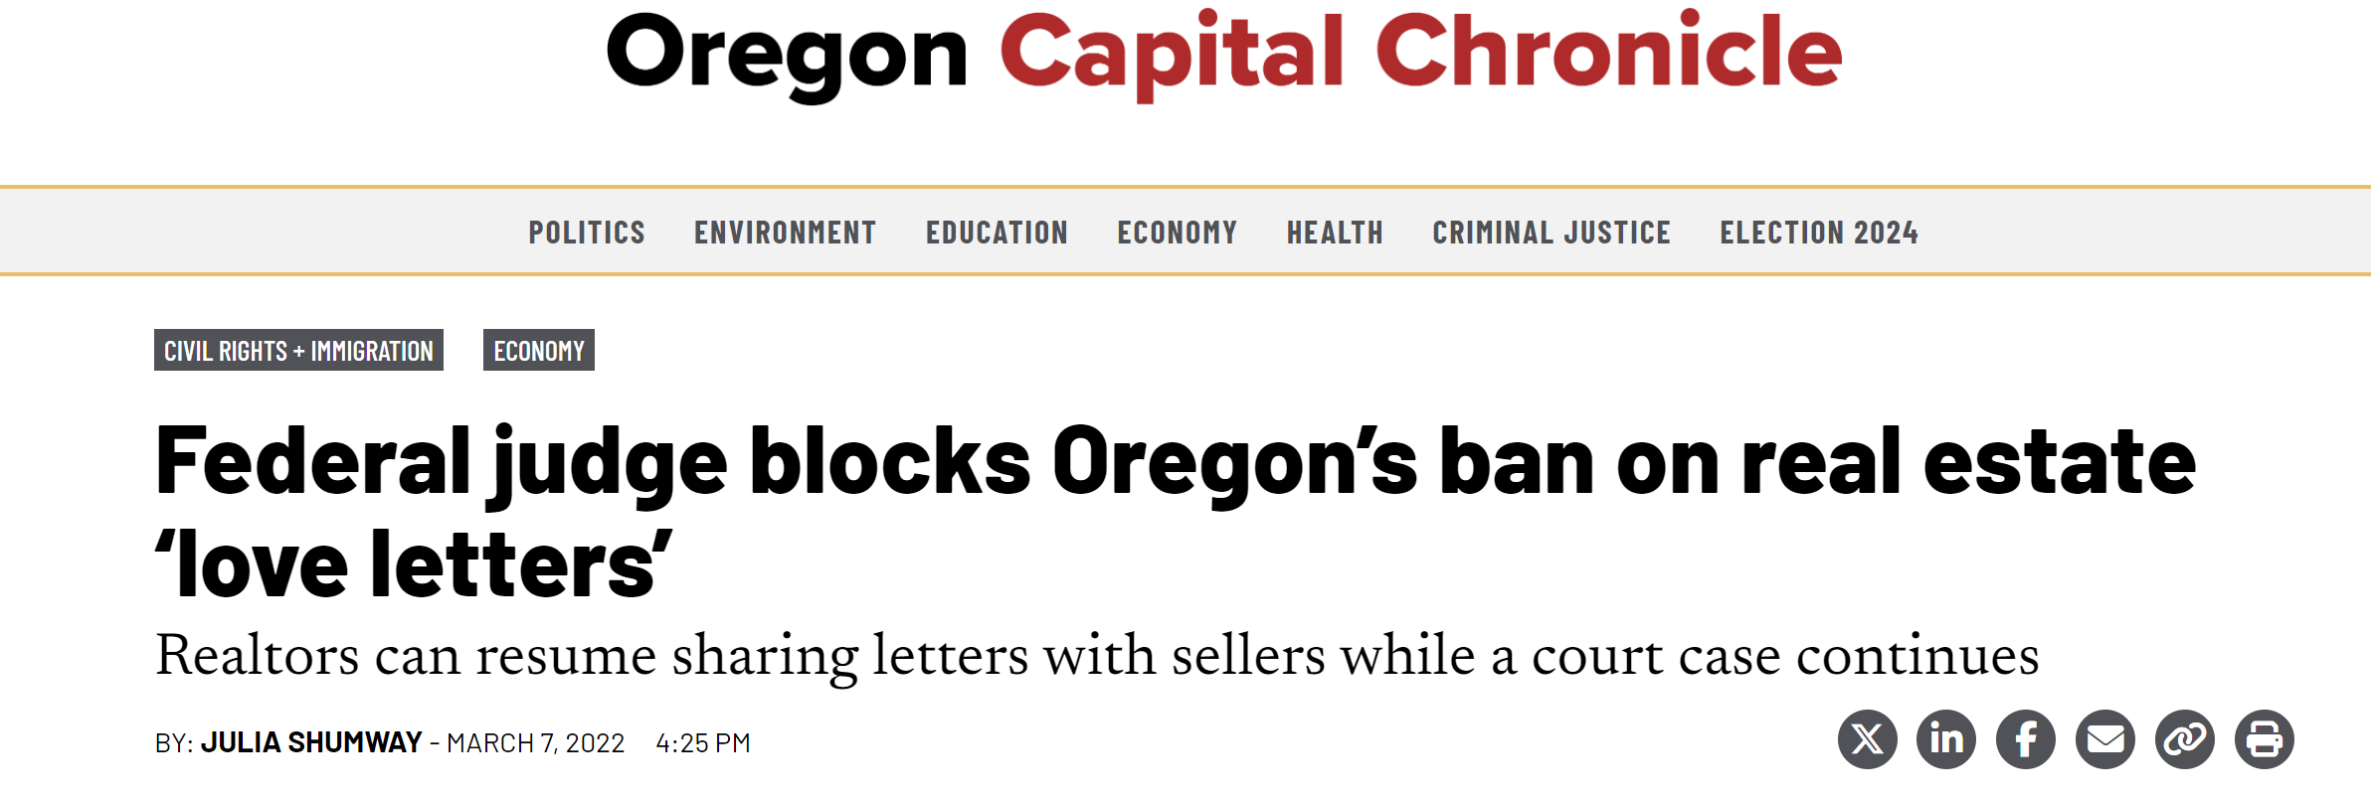
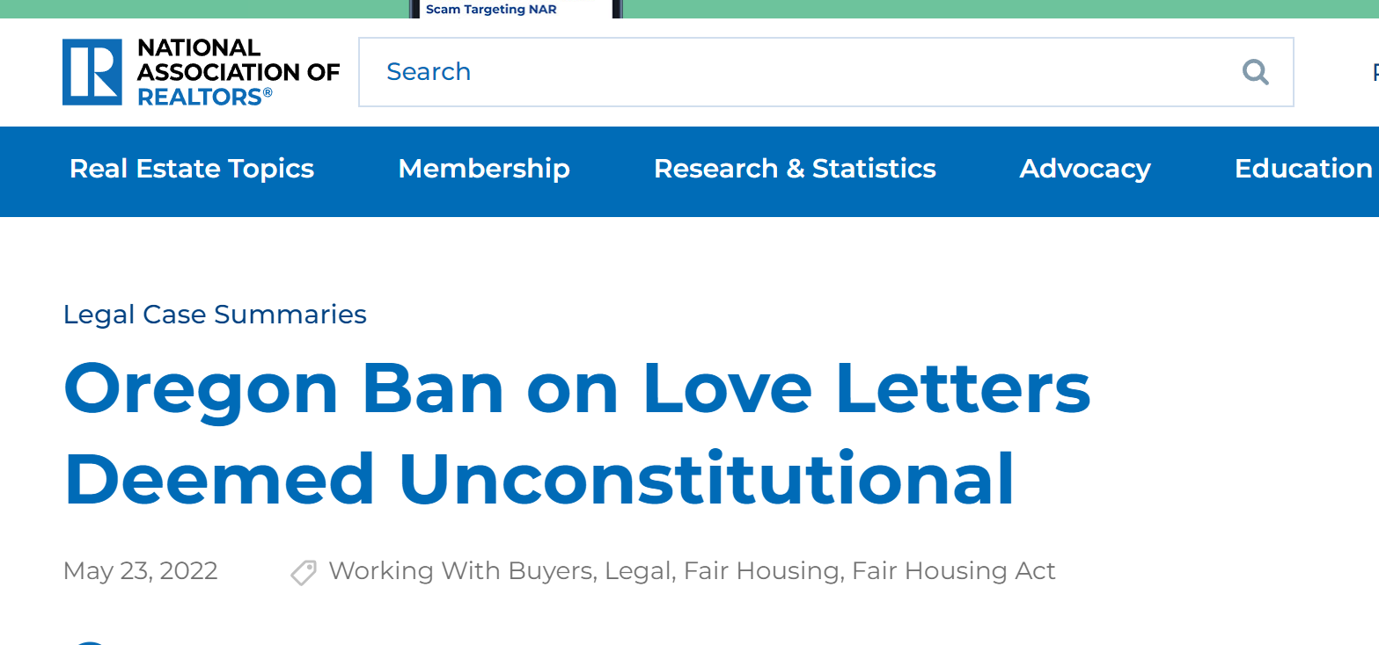

Slide 31
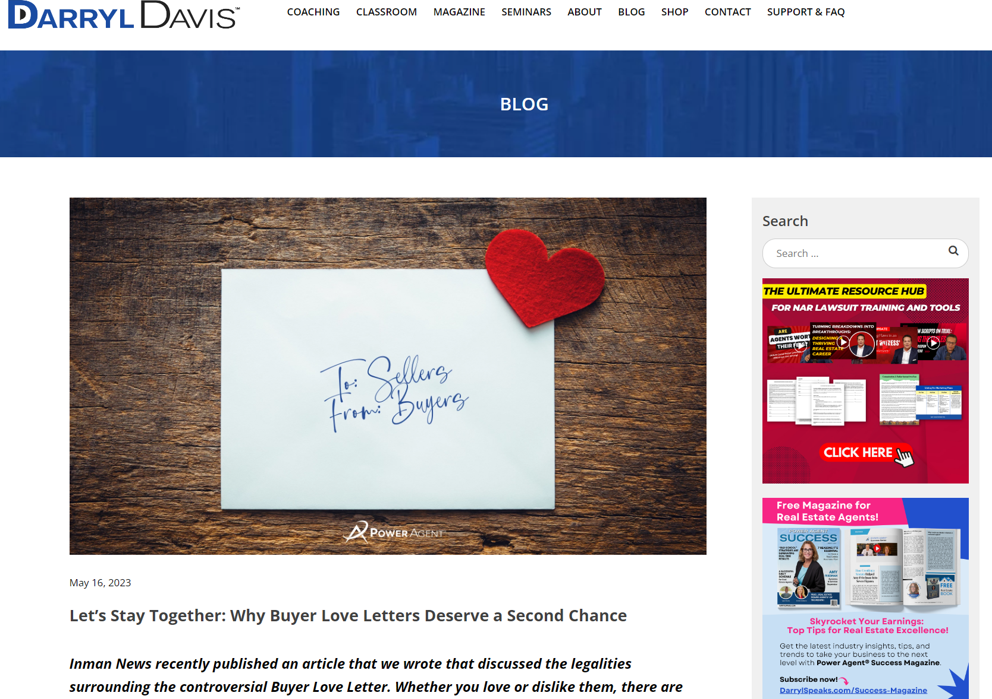
Notes:
https://darrylspeaks.com/lets-stay-together-why-buyer-love-letters-deserve-a-second-chance/

Slide 32
An Individual has violated the Fair Housing Act when they DENY someone housing based on their protected class
An Individual has NOT violated the Fair Housing Act when they ACCEPT someone into housing based on their protected class
TryThePowerProgram.com
Notes:
https://www.hud.gov/program_offices/fair_housing_equal_opp/fair_housing_act_overview

Slide 33

In an interview with the Texas Observer, Audriana Edwards, a black REALTOR®️ in Lubbock, said, “Whenever there’s a showing, there’s a Ring Camera on the front door. You know who is going to be in your house. Every day, there are many different kinds of discrimination in real estate. It could be from the camera, the letter, or the person dropping off their earnest money.” The seller can also see the buyer at the house if the owner is there or when the contract is signed. Even knowing the buyer’s name can sometimes be enough to cause bias. The point is that you can’t get away from it.​
If we ban the Buyer Love Letter because it “could” or “might” cause discrimination, the next step would be to make sellers turn off their cameras, only show houses when the seller isn’t home so they don’t run into the buyers, and hide the buyers’ names on all documents. If you really want to avoid any chance of bias, we might as well not show any buyers any homes at all.
TryThePowerProgram.com
Notes:
https://darrylspeaks.com/lets-stay-together-why-buyer-love-letters-deserve-a-second-chance/

Slide 34
To Summarize, The Buyer Love Letter…
Does Not Violate Any Laws
Any Rule That Prevents Love Letters IS Denying a Person’s First Amendment Rights & Is a Lawsuit You Will Lose
The Only Time There Is a Violation of Fair Housing You Would Have to Prove What Was In The Mind of The Seller.
TryThePowerProgram.com

